Slide 1
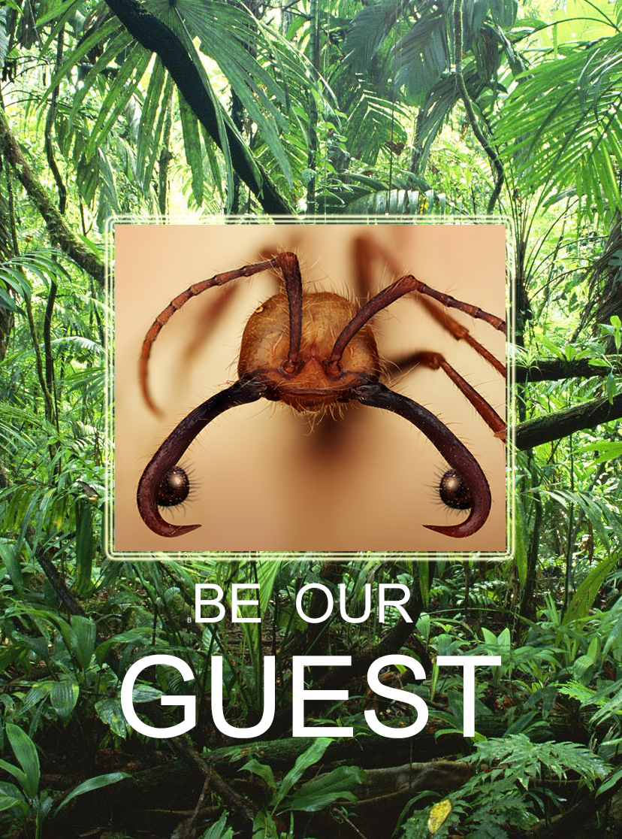
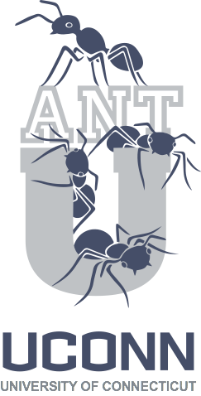
Notes:
The AntU project invites those in all disciplines to interpret the biology of army ants and their guests through their own special lens.

Slide 2
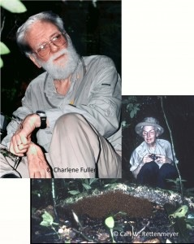

Carl W. & Marian E. Rettenmeyer
Army Ant Guest Collection (AAGC)
50+ years of field work
South & Central America
AAGC Collection:
2+ million specimens army ants
& their “guests”
~5,000 Associated field cards
~5,000 Kodachrome slides
Notes:
The AntU project was inspired by a phenomenal collection that resulted from the life-work of biologists Carl and Marian Rettenmeyer.

Slide 3
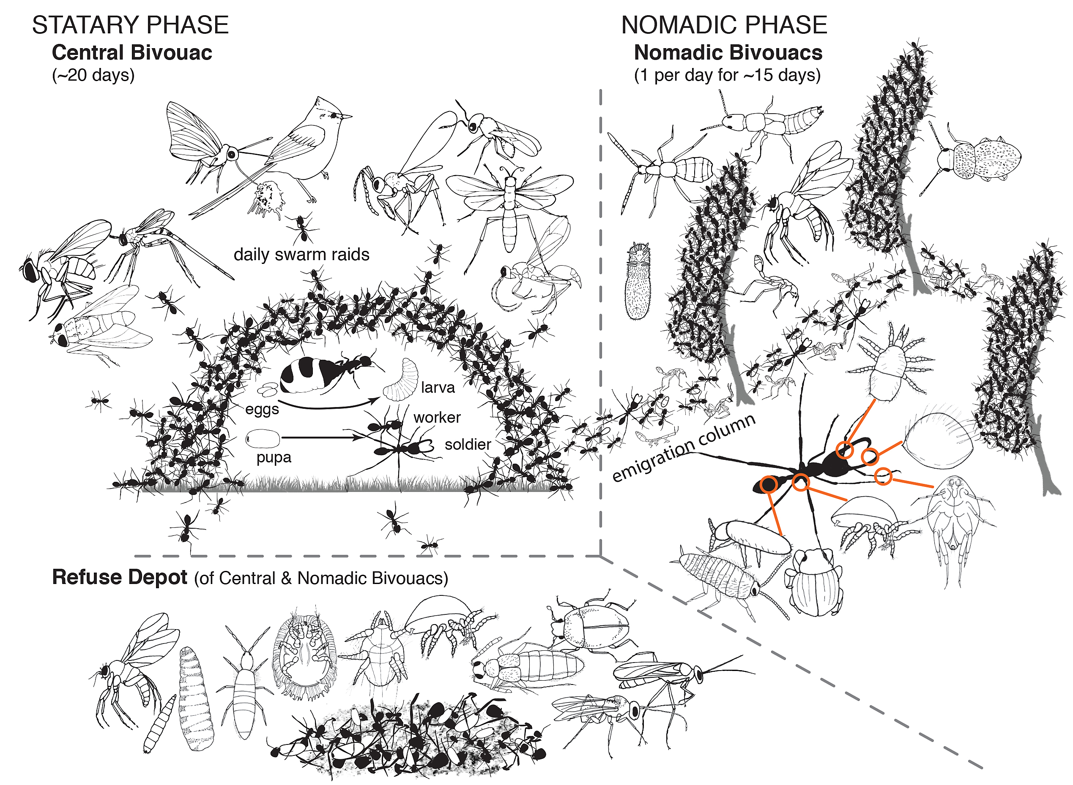
Army ants & their “guests”
Notes:
The biology of an army an colony is extremely complex. Army ants are intimately associated with hundreds of other species of organisms, including wasps, flies, mites, butterflies, etc. that live in association with them as their “guests”. The term “guests” is used for these organisms because in many cases the relationship between the “guests” and army ants is unclear. Some are clearly parasites and harm the ants; others appear to aid the ants and are thus mutualists. The nature of the relationship between army ants and many of their other “guests” remains unknown.

Slide 4
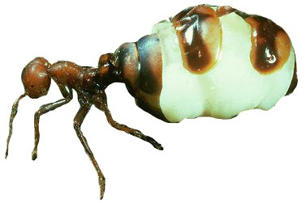


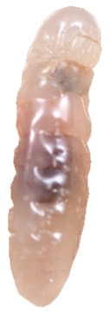
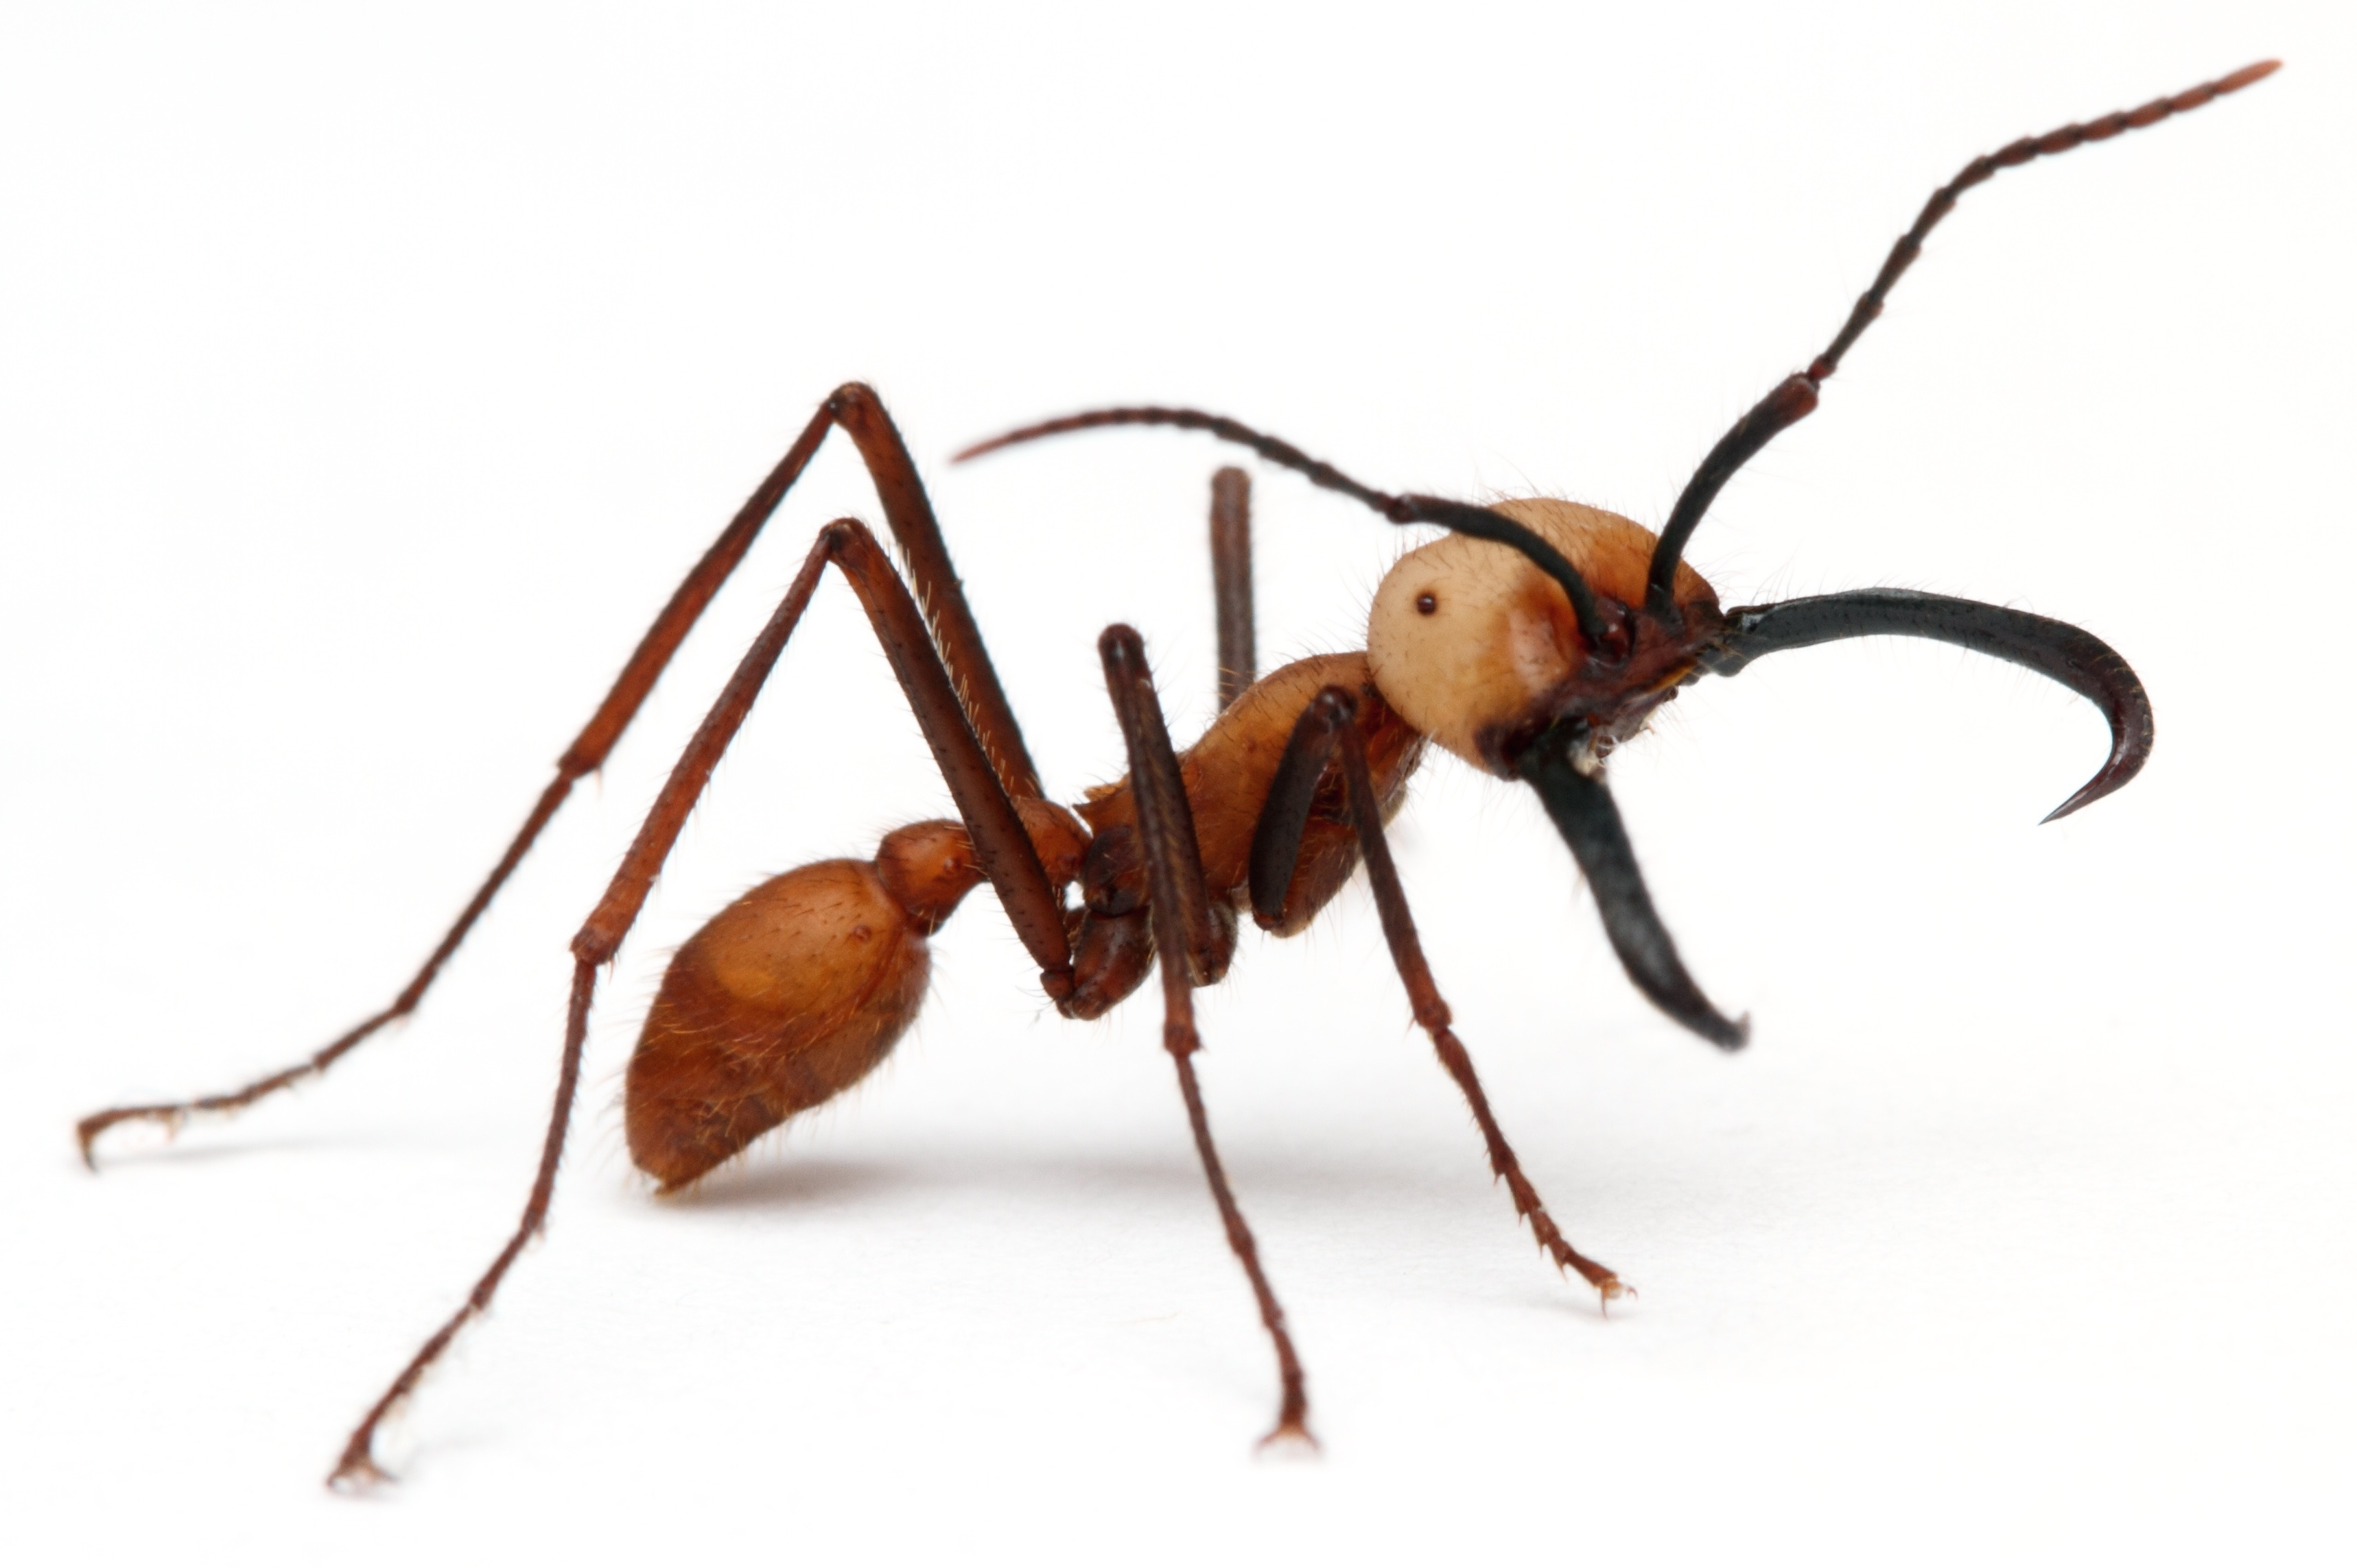
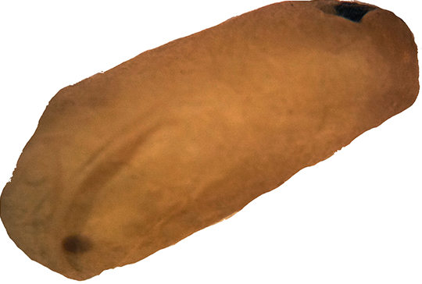
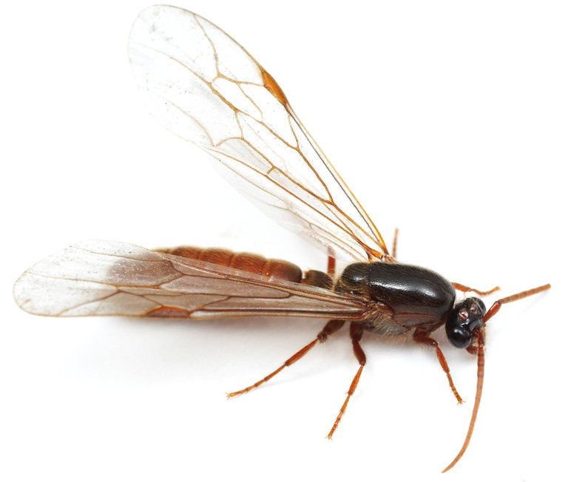
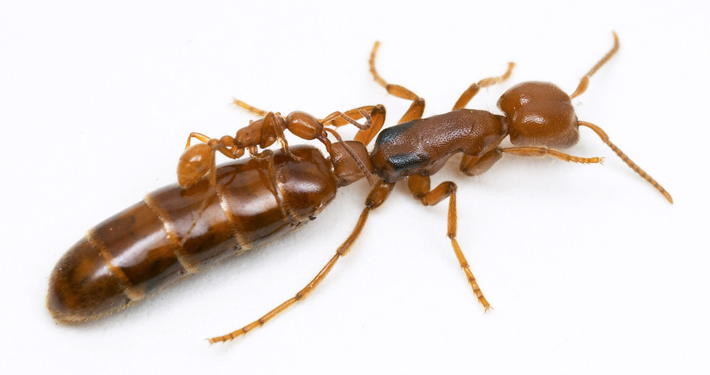

Army Ant Life-cycle
gravid Queen
eggs
larva
pupa
major soldier
minor soldier
male
Queen
Notes:
The life-cycle of army ants is somewhat complex. There is a single queen who mates with a short-lived male. The queen then lays tens of thousands of eggs. Larvae hatch from the eggs and develop into pupae. By far the majority of the ants that develop from pupae are females. Some of these are small workers (called minor soldiers) that tend the queen and help nourish the rest of the ants in the colony by finding food. Others are larger and are called major soldiers; they protect the colony from predators. Once or so a year some of the pupae develop into males, but these leave the colony to mate with queens of other colonies.

Slide 5
Army ants & their “guests”
Notes:
The life of army ants involves the repeated alteration between two phases—the statary (or stationary) phase and the nomadic phase. During the statary phase, the ants remain in a central bivouac (made up entirely by the ants which attach to one another with the claws at the tips of their legs) for approximately 20 days. During that time some ants leave the colony in search of food. Much of the development of the ants also occurs during this phase.

Slide 6
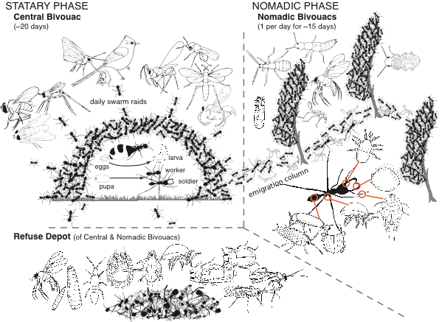
Notes:
During the 20 days of the statary phase the queen lays hundreds of thousands of eggs and they develop into larvae. Also during this phase, pupae develop into adult solder ants.

Slide 7
Notes:
A variety of “guests” are associated with army ants during their statary phase. These include flies, wasps, ant birds that take advantage of prey flushed up by swarming colonies of army ants, and the little butterflies that obtain water from the faeces produced by the ant birds.

Slide 8
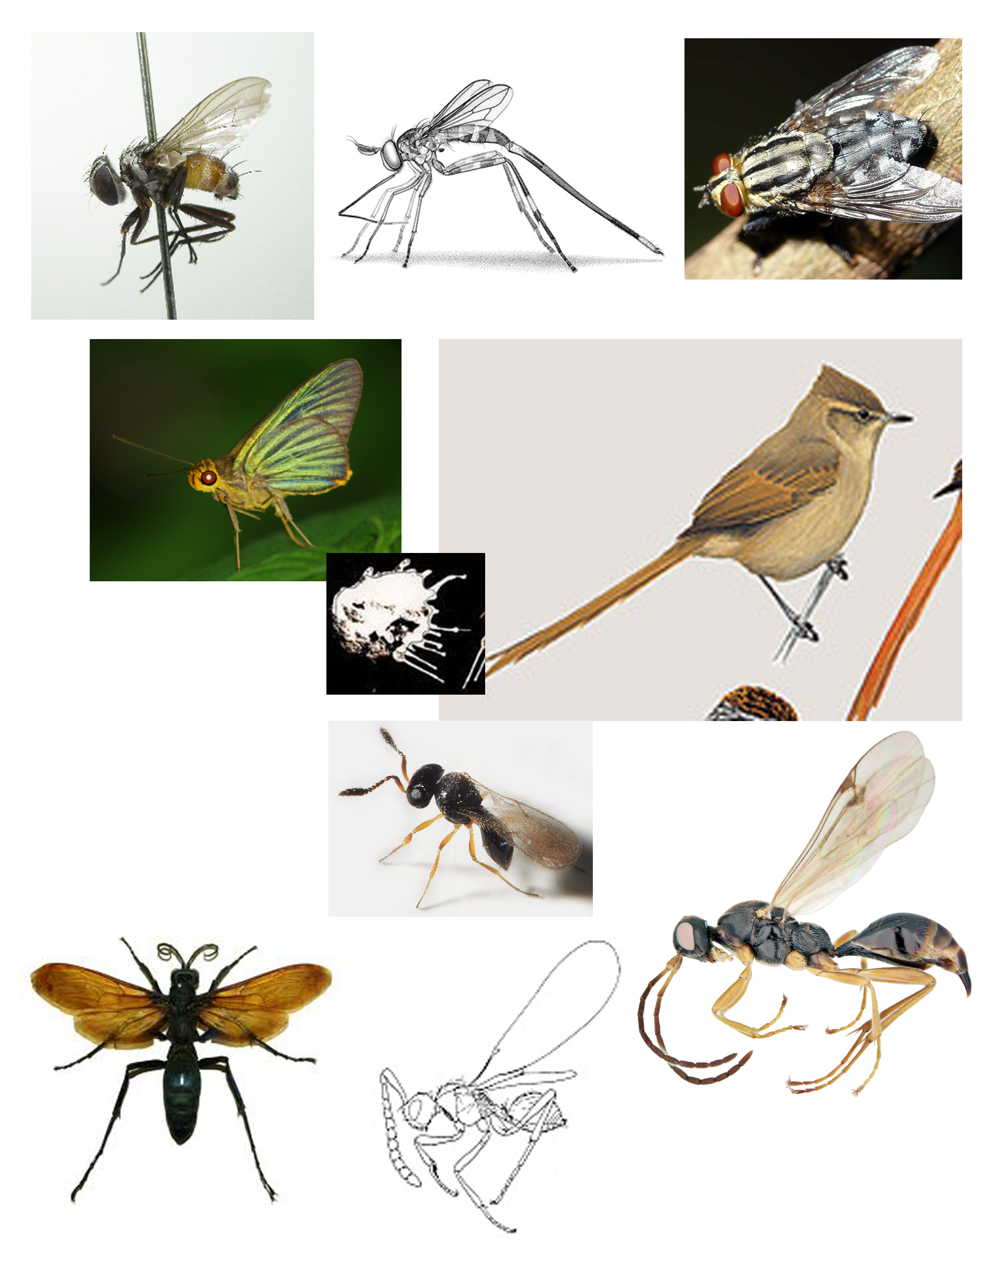
Notes:
In order from top left to bottom right: fly, wasp, fly, butterfly, ant bird faeces, ant bird, wasp, wasp, wasp, wasp.

Slide 9
Army ants & their “guests”

Slide 10
Army ants & their “guests”
Notes:
As the statary phase comes to an end (and the ants have often consumed all of the food surrounding the central bivouac), the ants begin the nomadic phase, which will last for about 15 days. During this phase the entire colony moves to a new location; the migrating swarm of ants is called an emigration column. Individual larvae are transported by individual minor soldier ants. For 15 days the ants travel during the day and, each night, they come together in nomadic bivouacs.

Slide 11
Notes:
The nomadic bivouacs are temporary, lasting only a single night.

Slide 12
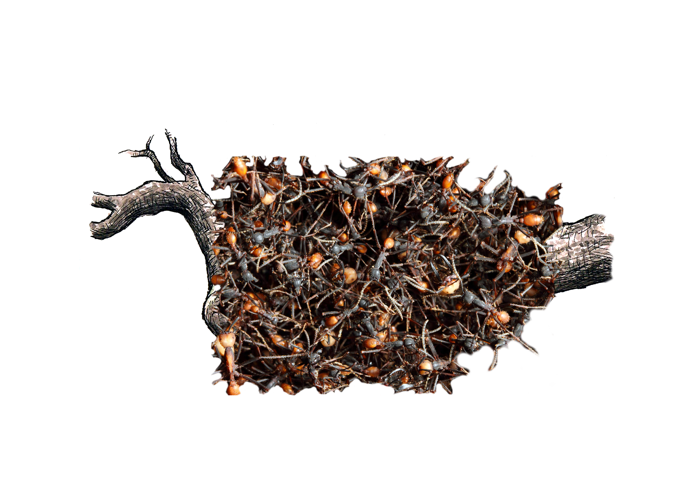
Army Ant Bivouac
Notes:
Once again, these bivouacs are made up of the bodies of major and minor soldier ants. The larvae are located in the center of this mass, protected from predators.

Slide 13
Notes:
The ants are accompanied by many of their guests during their nomadic journey.

Slide 14
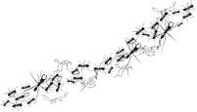
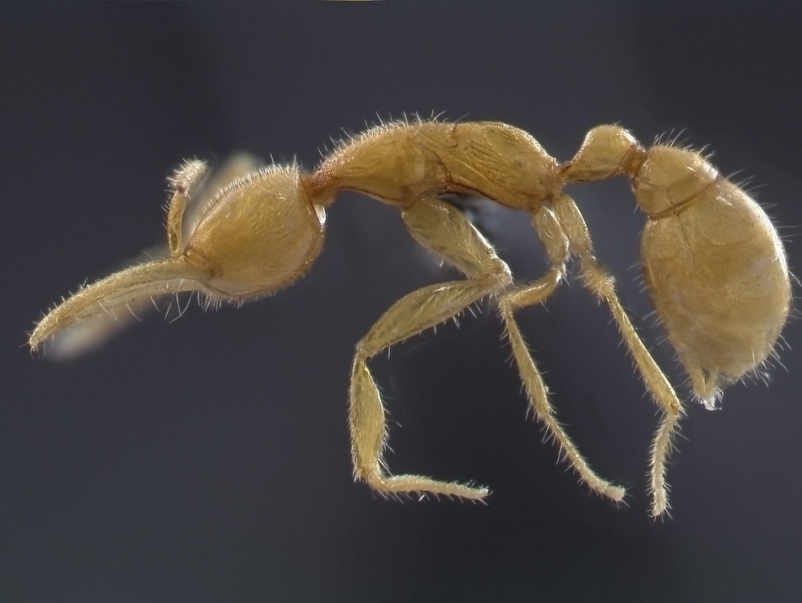
Myrmecoid staphylinid beetles
Notes:
Many of these guests have evolved over time to resemble the ants, perhaps so as to remain undetected as non-ants within the colony. For example, there are a variety of beetles that look very much like ants.

Slide 15
Notes:
There are also guests that have come to resemble army ant larvae.

Slide 16
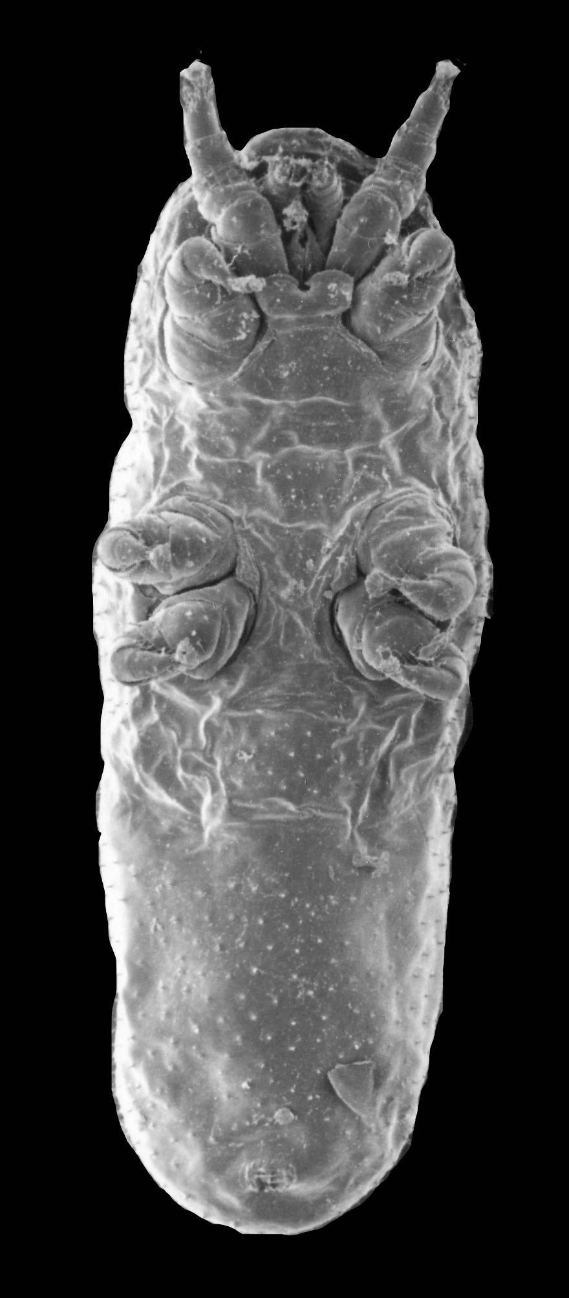
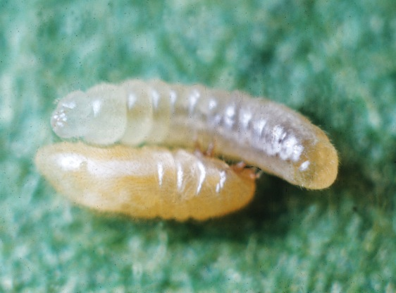
Larvamima
Ant larva
mite
Notes:
An example is the mite Larvamima. Which, as adults, are difficult to distinguish from ant larvae…except that, unlike ant larvae, these mites have legs.

Slide 17
Notes:
There are also guests that live most of their lives on the body of army ants.

Slide 18
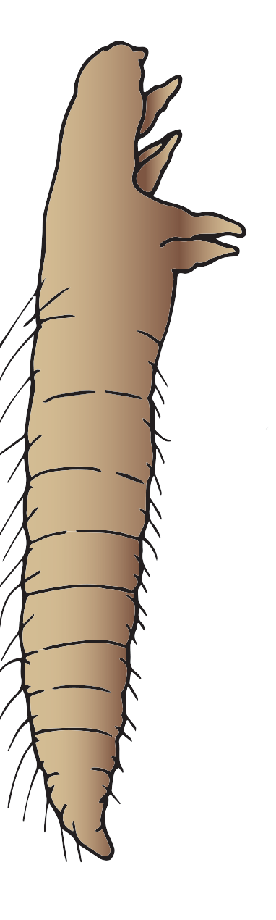
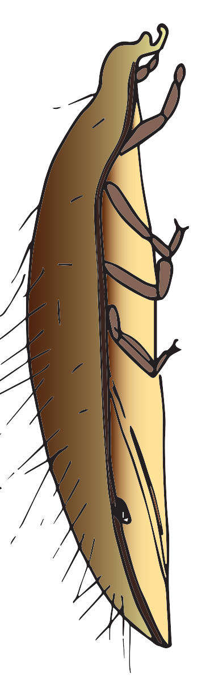
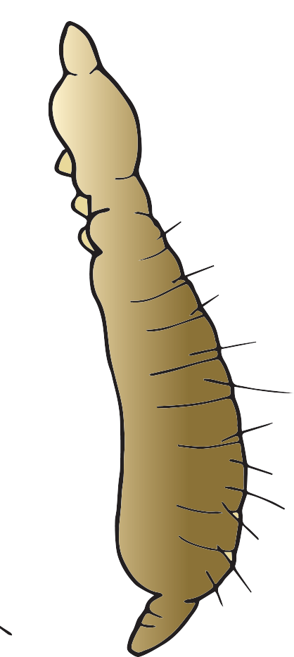
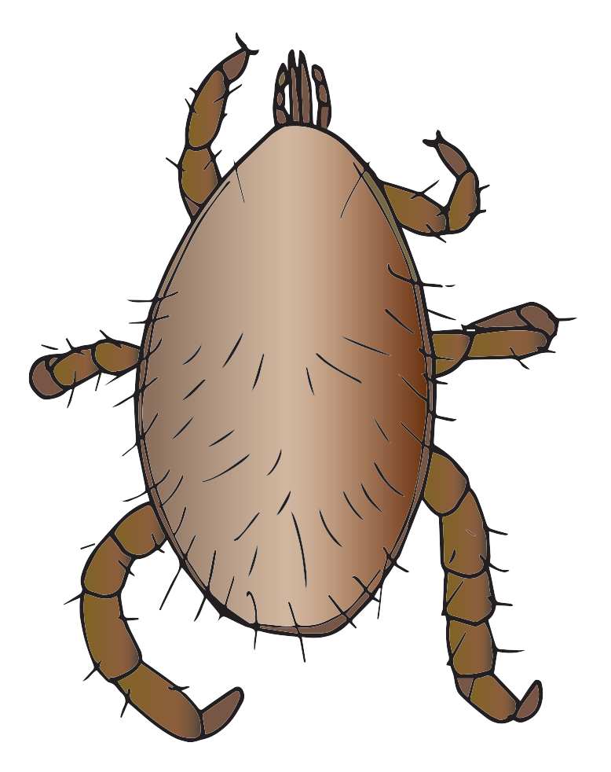
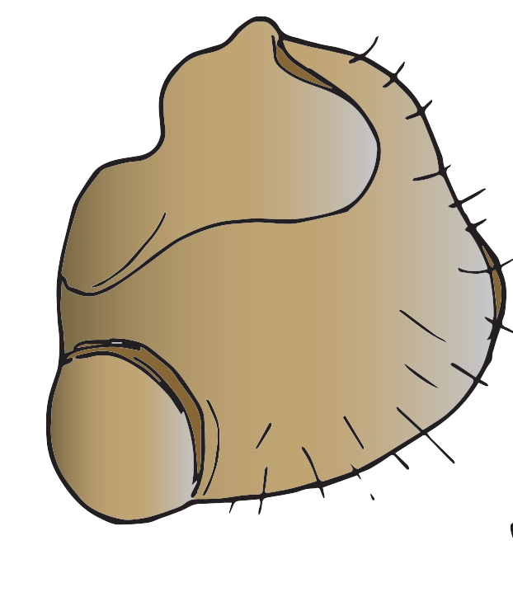
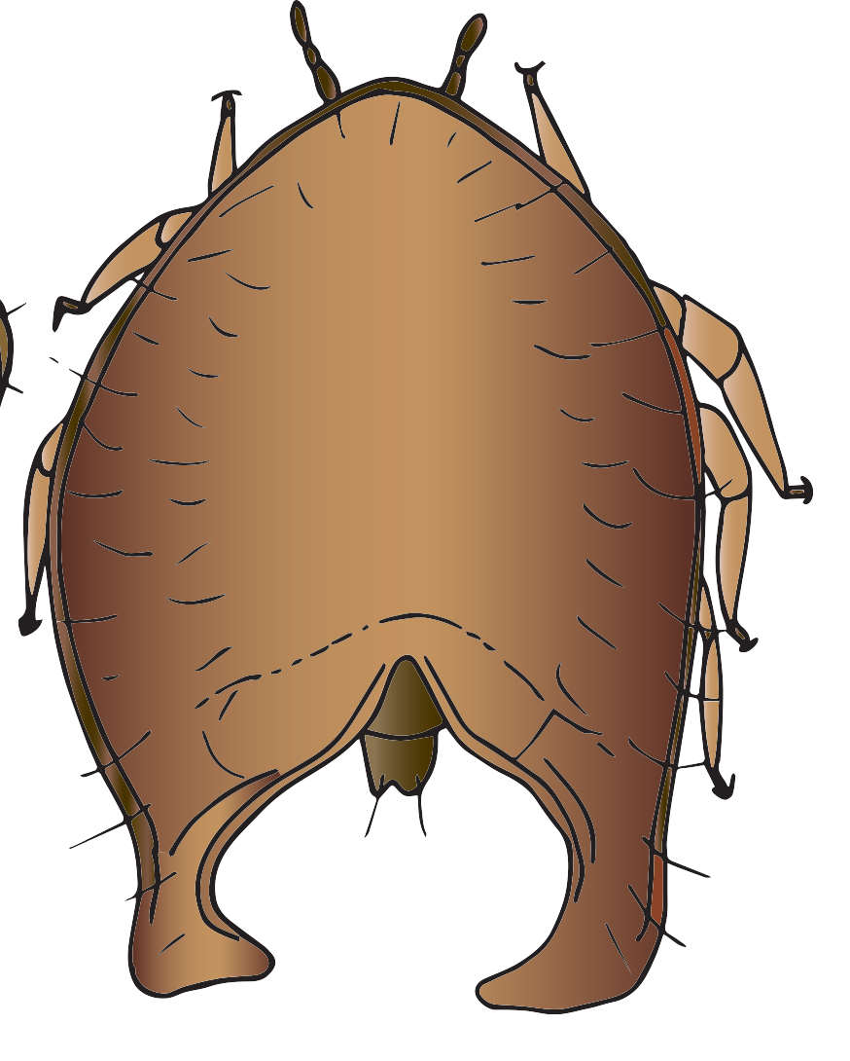
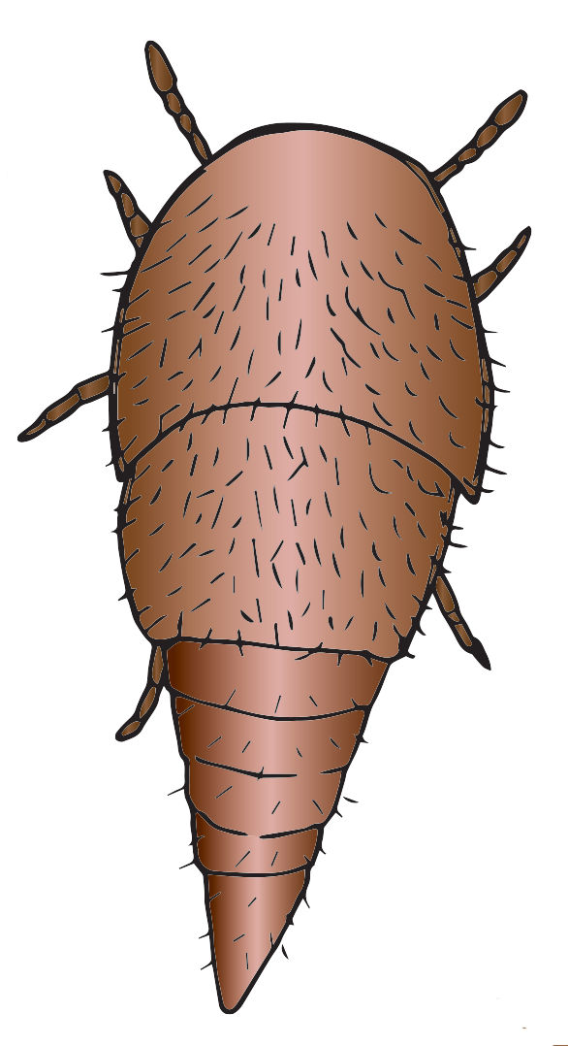
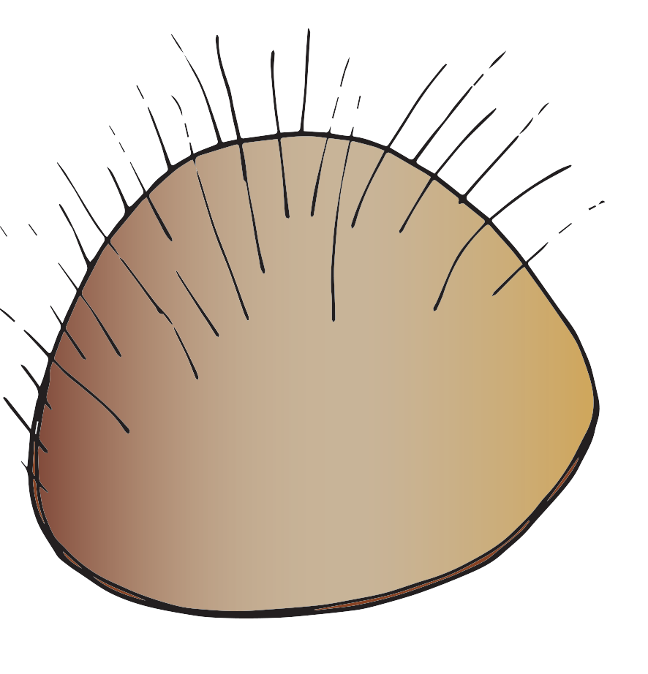
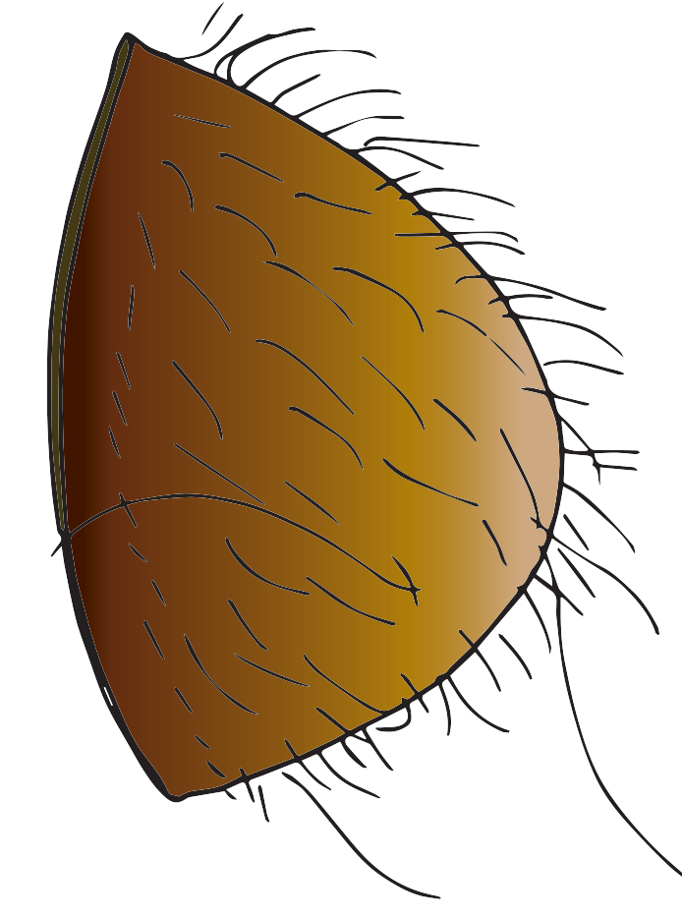
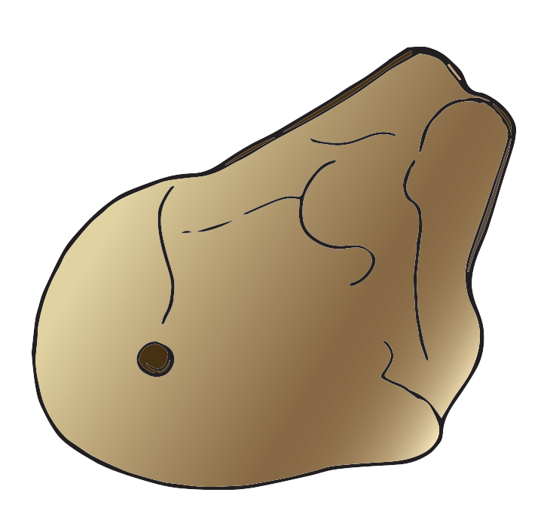
Macrocheles
Pinoglyphus
Planodiscus
Antennequesoma (leg)
Coxequesoma
Habeogula
Trichocylliba
Circocylliba
limulodid beetle
Antennequesoma (antenna)
Notes:
These guests, many of which are also mites, have evolved into a variety of different forms, depending on where on the body of the ant they live.

Slide 19
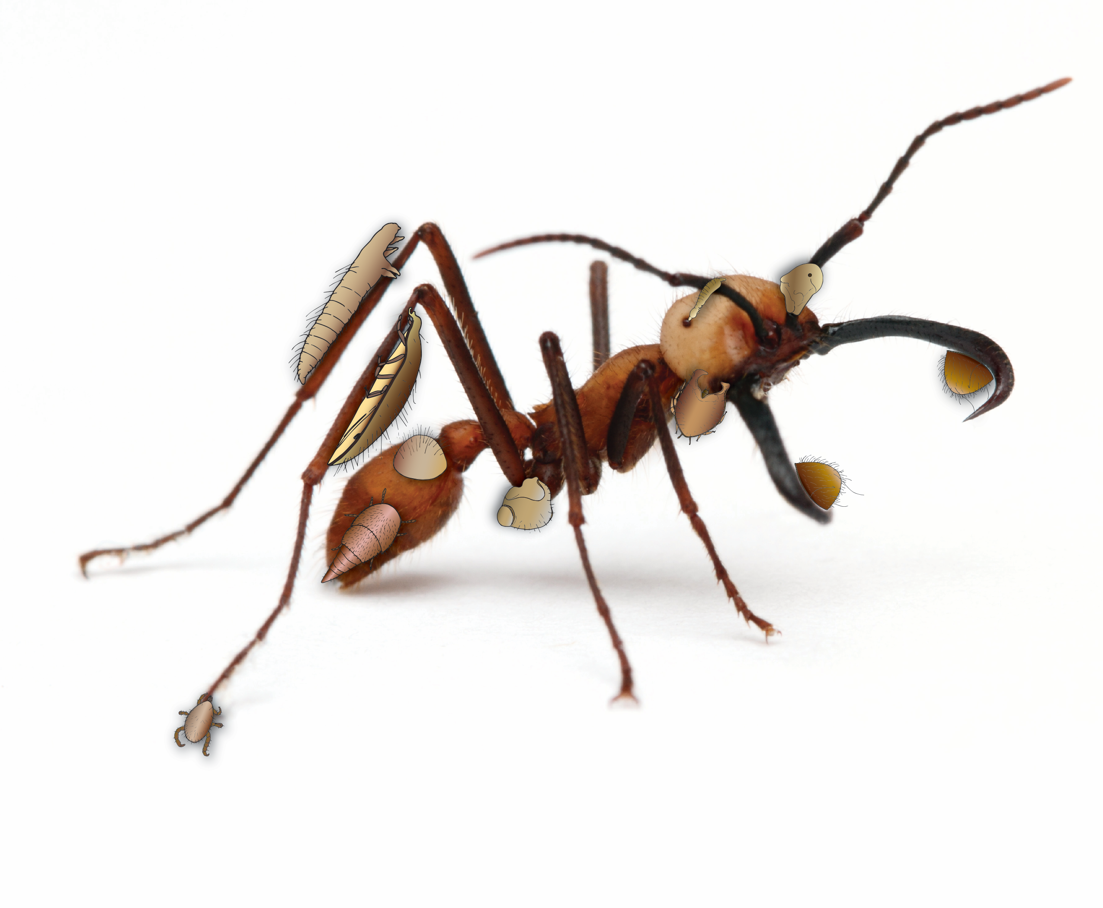
Notes:
Most guests live in very specific sites on the body of their army ant. Some of the more iconic guests are shown here; but it is extremely uncommon for an ant to host more than one of these guests.

Slide 20
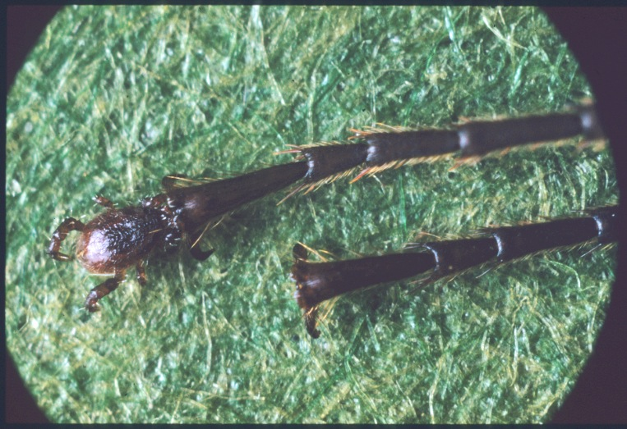
Macrocheles
ant leg
mite
Notes:
The mite guest Macrocheles lives at the tip of the leg of the ant. Its hind legs are thought to serve the same function as the claws at the tips of their legs. Some ants with Macrocheles at the tips of their legs have actually been observed attaching to other ants with the high legs of Macrocheles f one ant attaching to the claws of another ant.

Slide 21
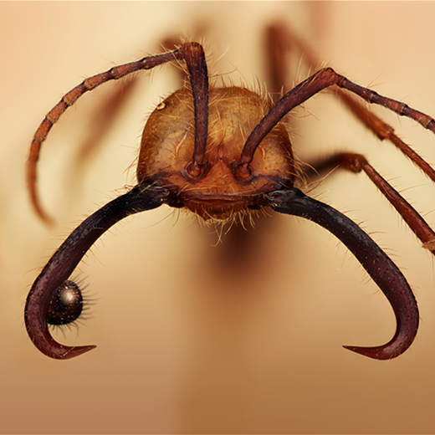
Circocylliba
mite
ant mandible
Notes:
Ant guests such as Circocylliba attach on the inside of the giant jaws of major soldier ants.

Slide 22
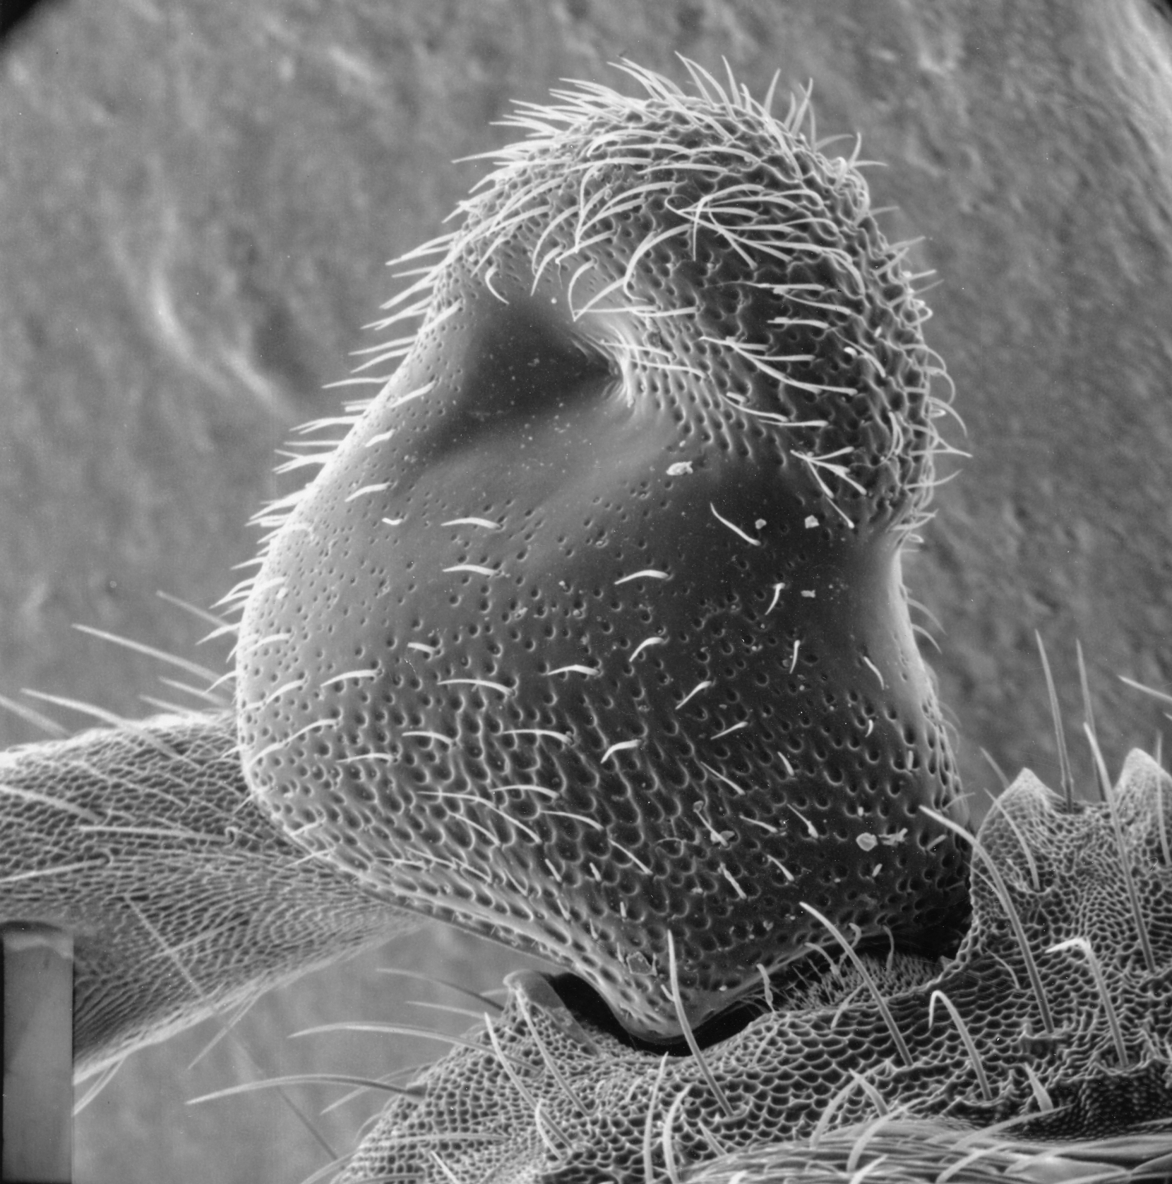
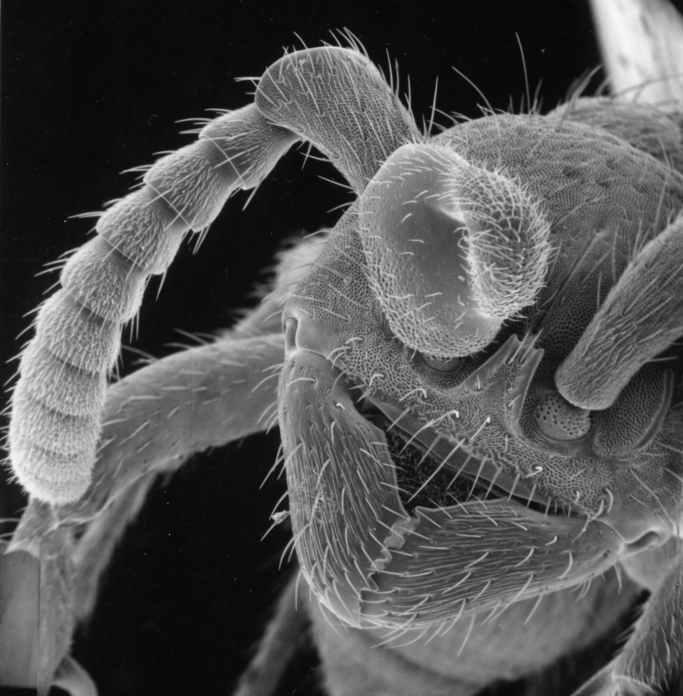
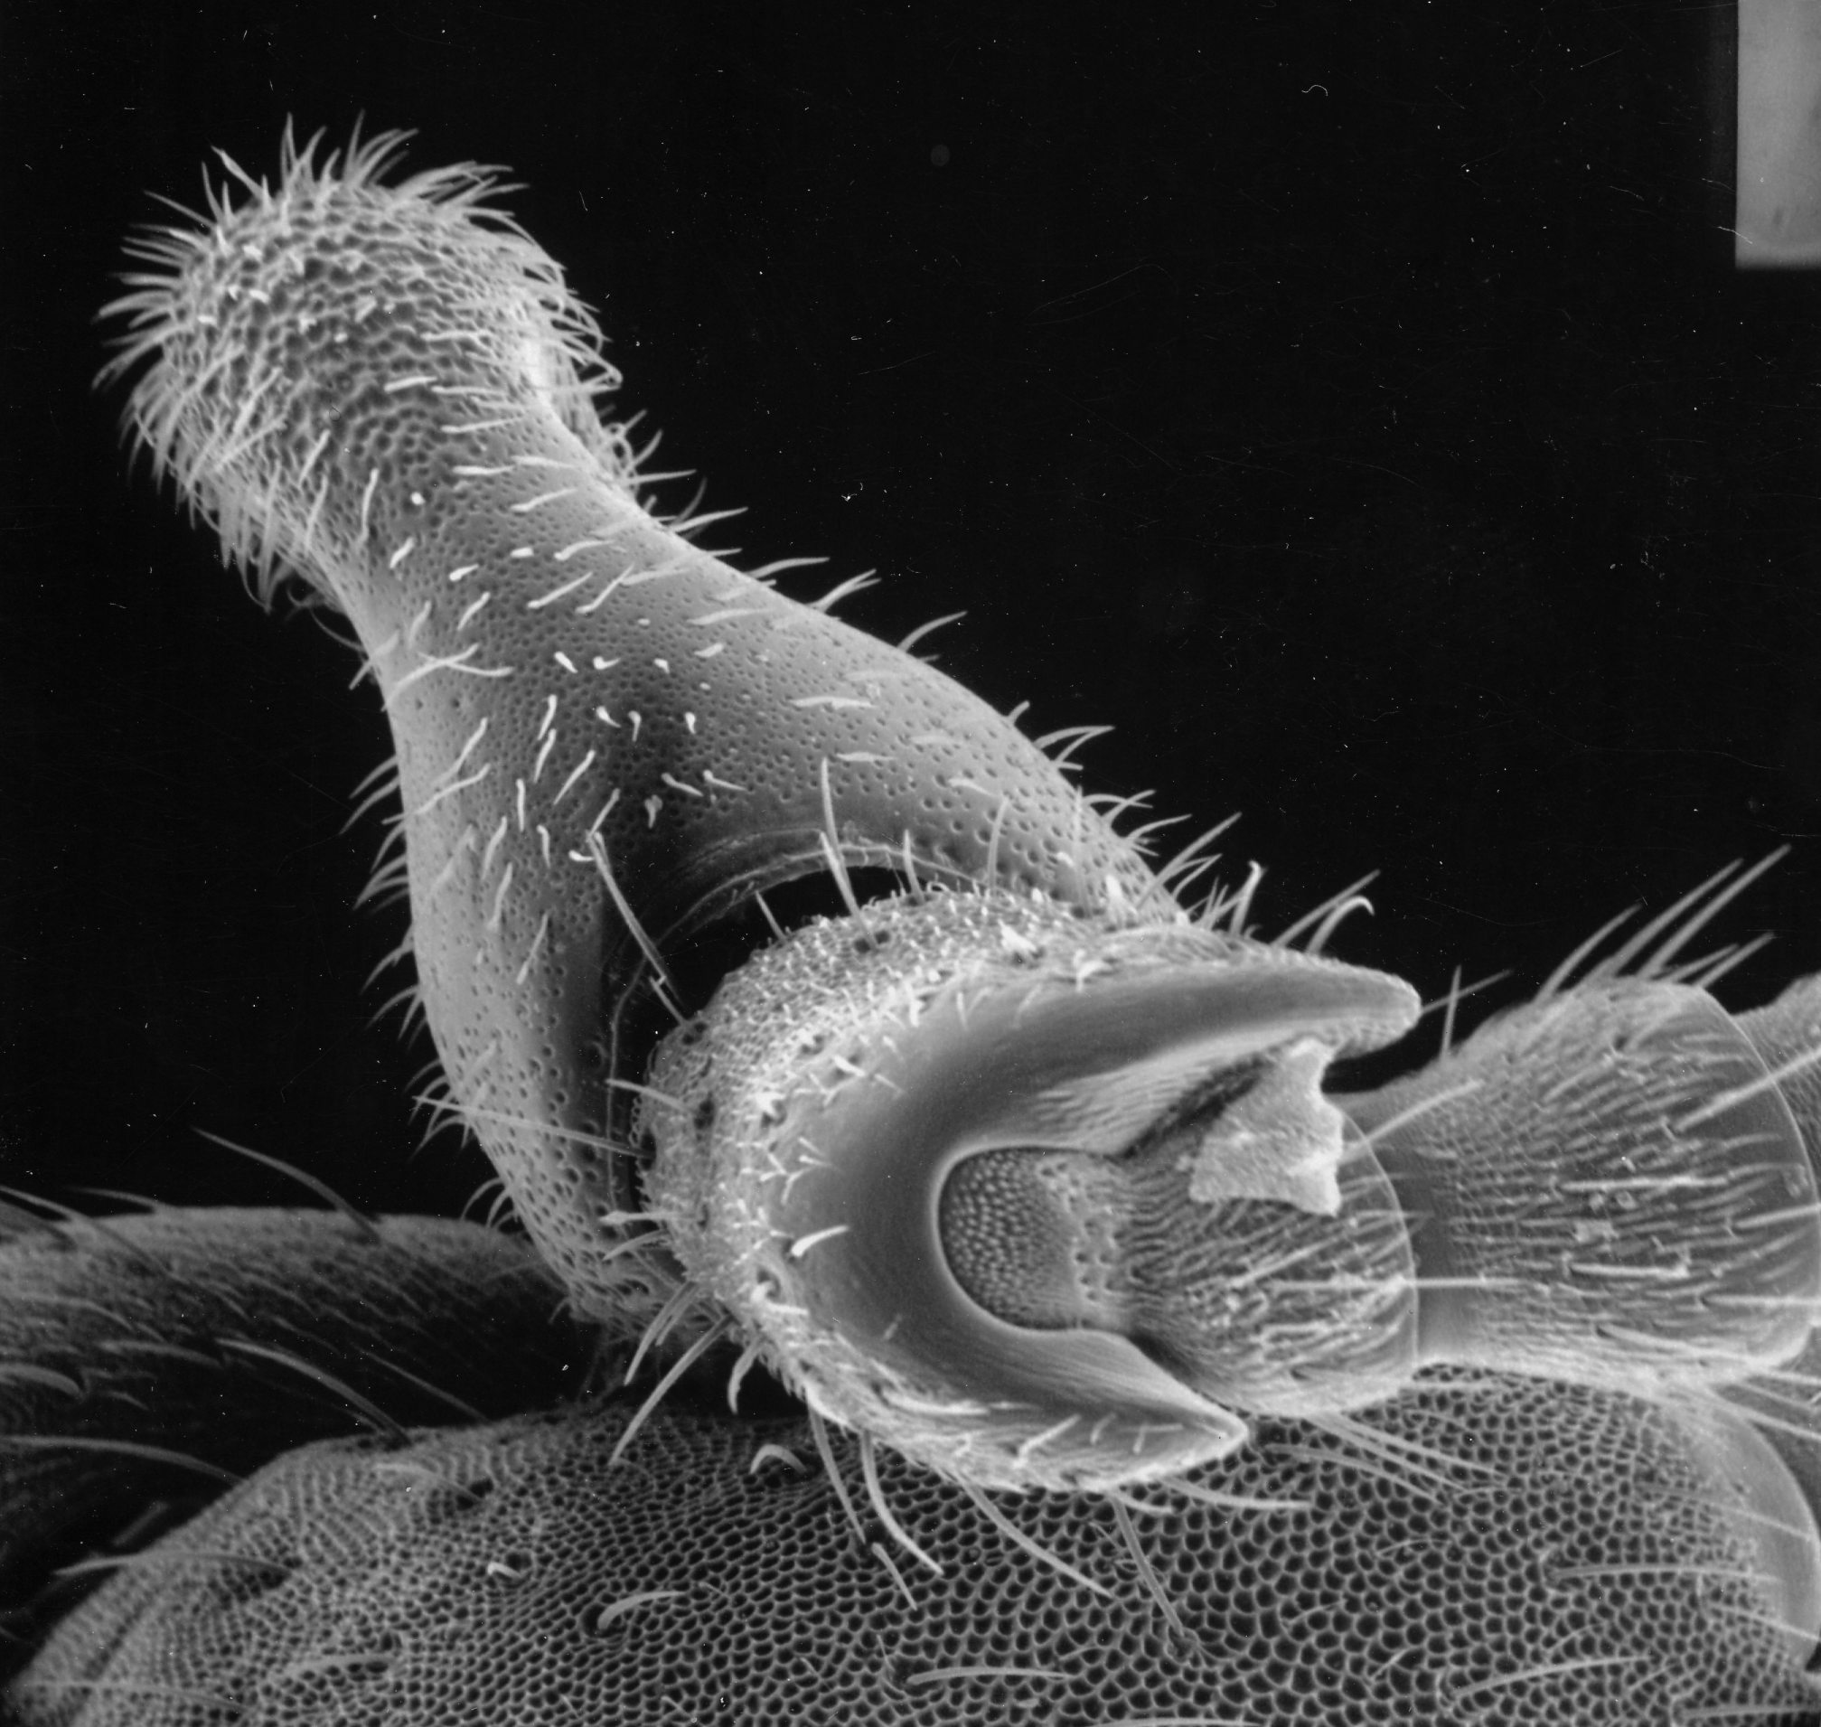
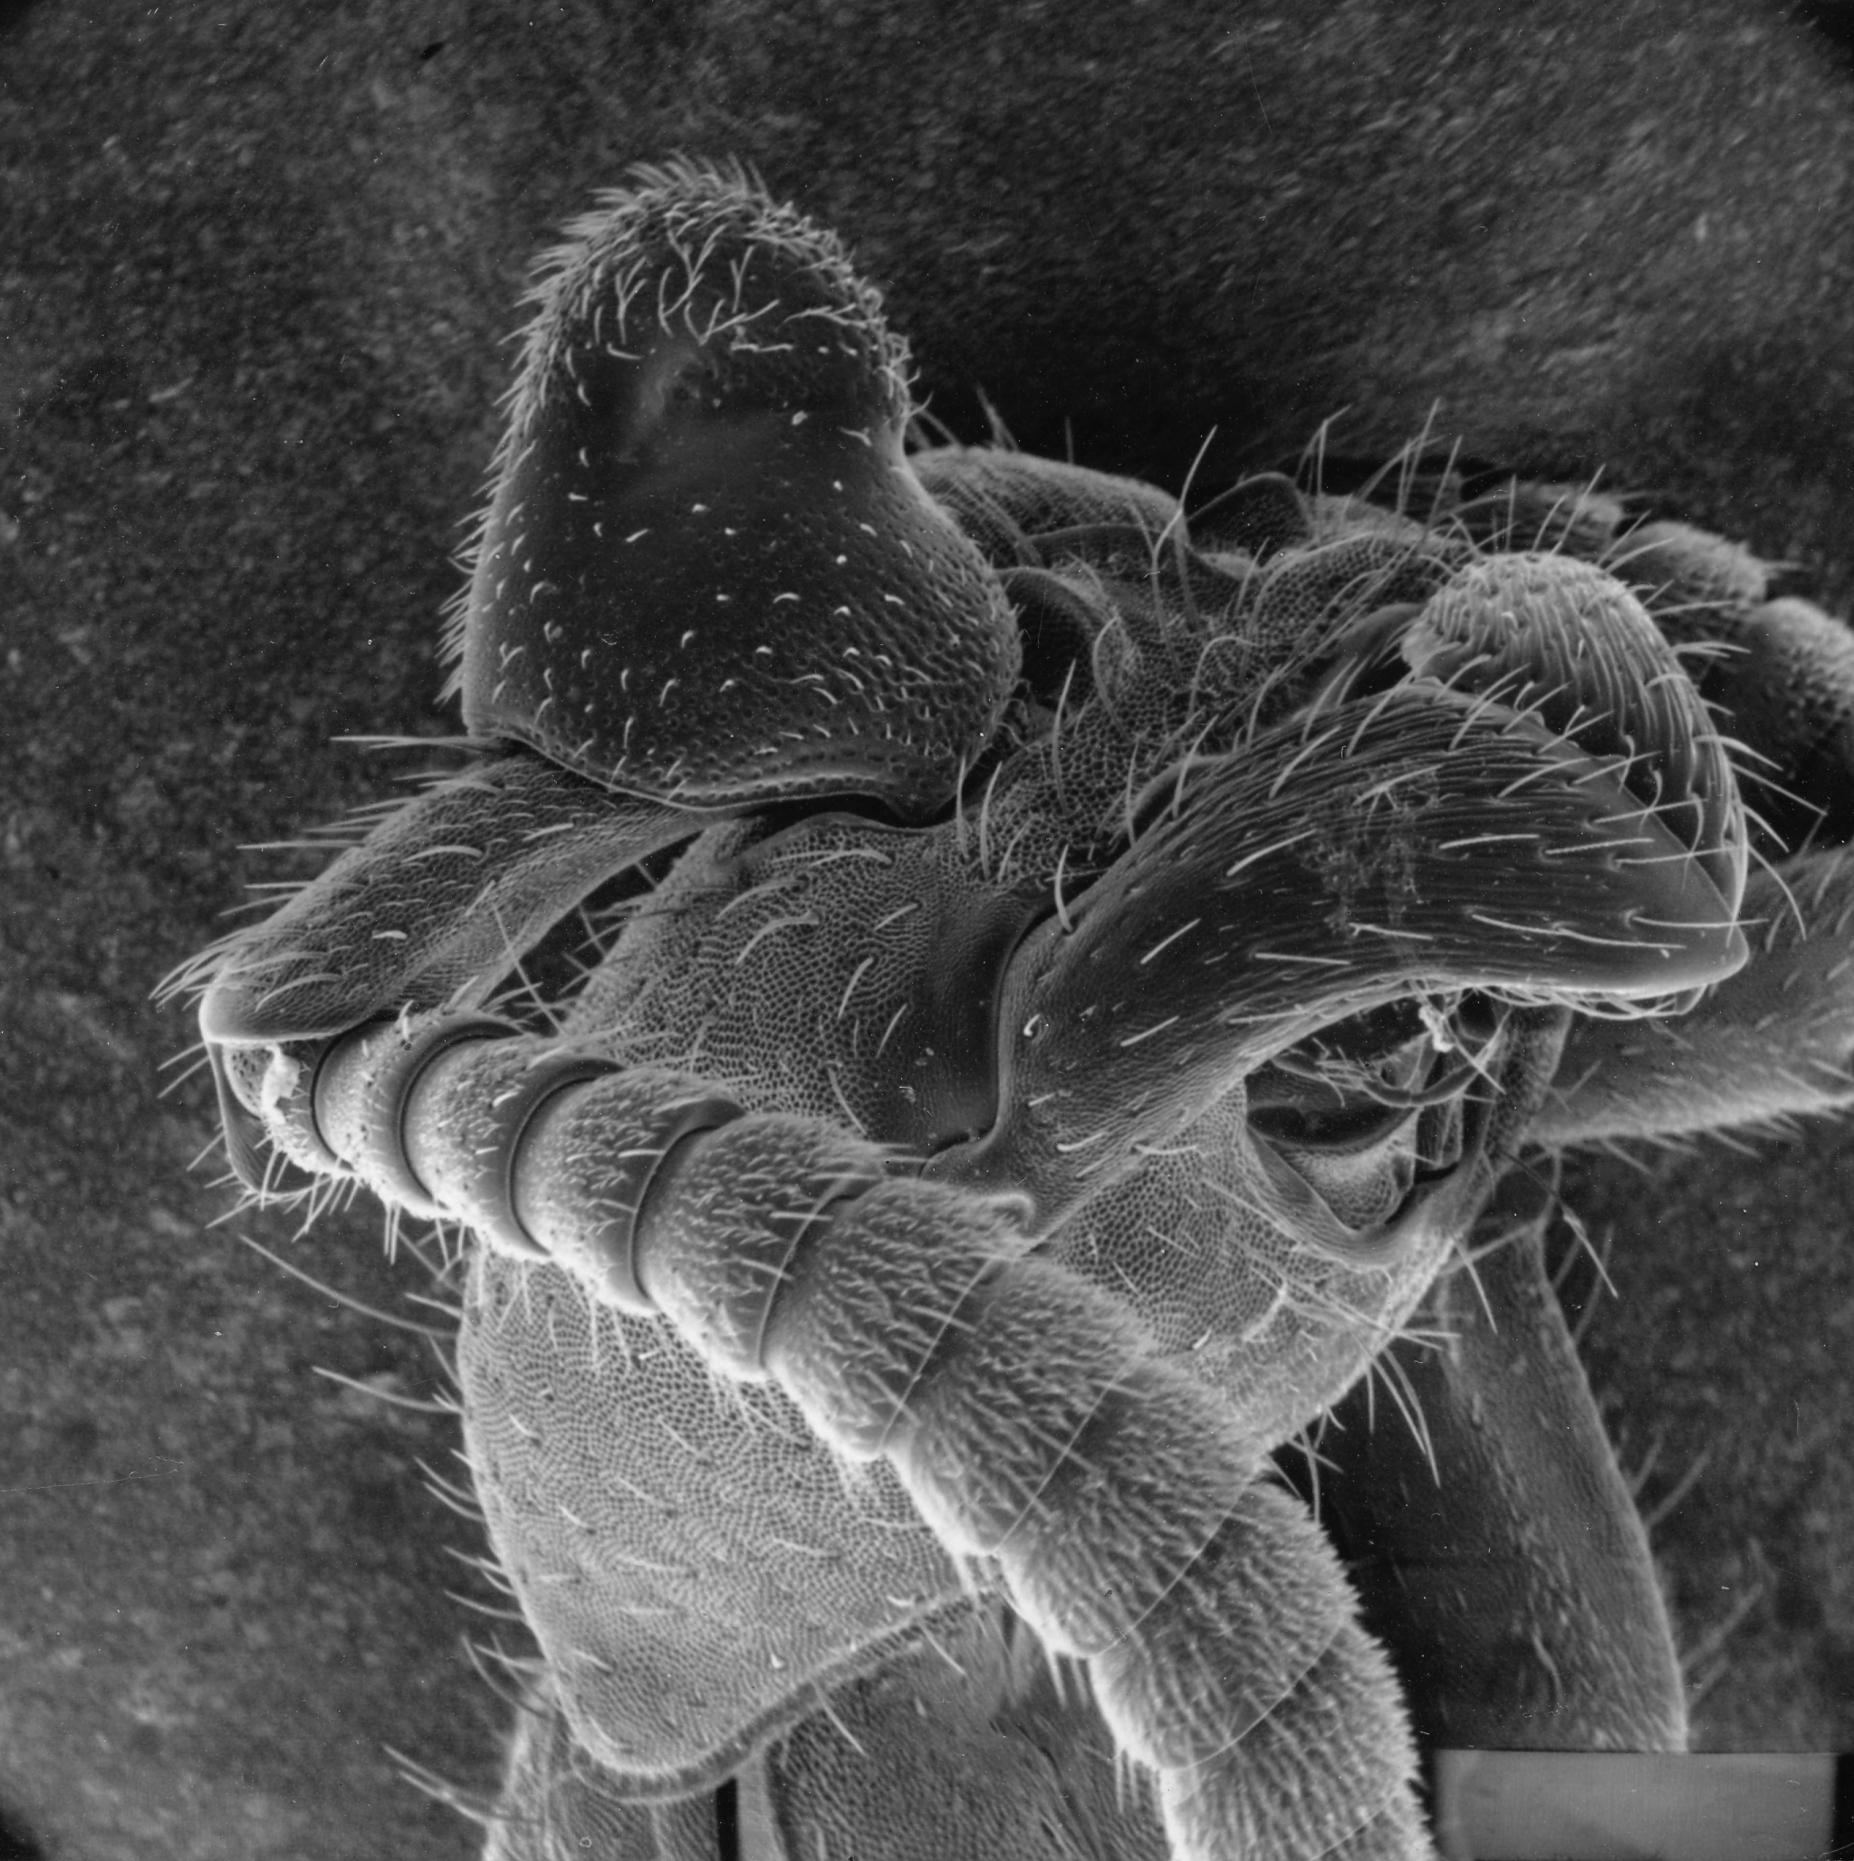
Antennequesoma
Notes:
Mite guests such as some species of Antennequesoma attach at the base of the antennae of the ants. They even bear surface bristles (setae) that resemble those of the ant.

Slide 23
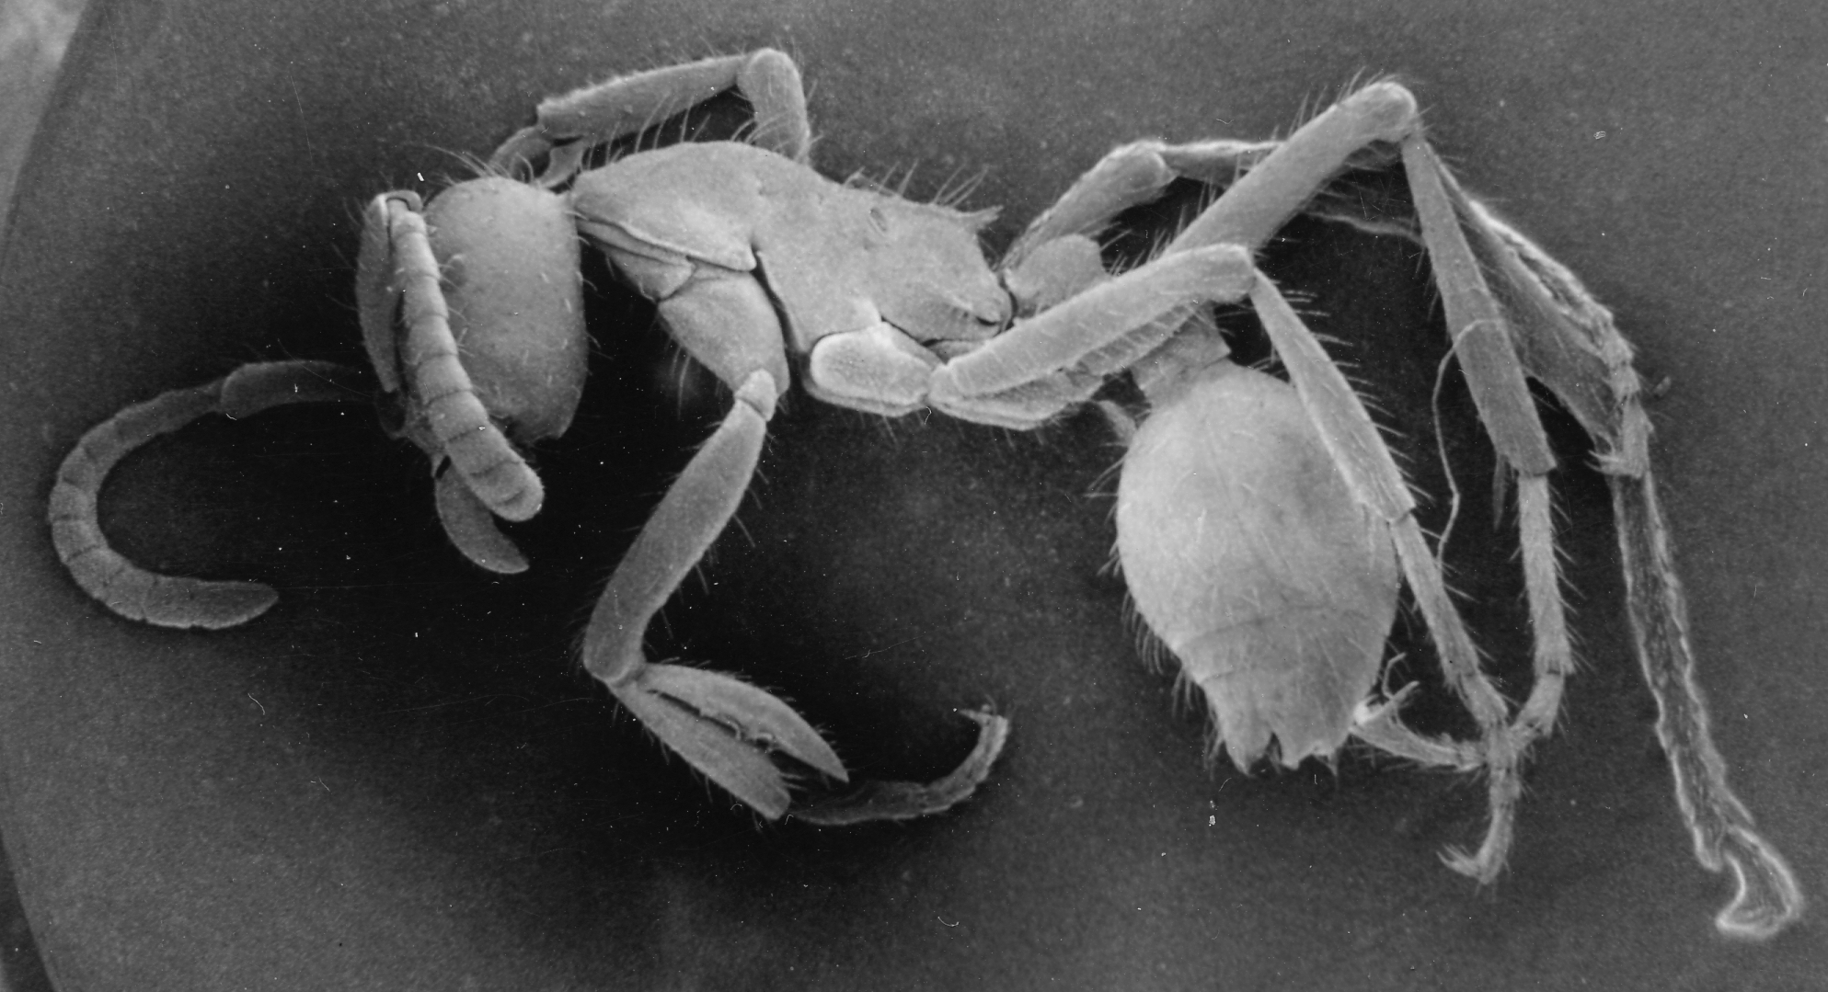
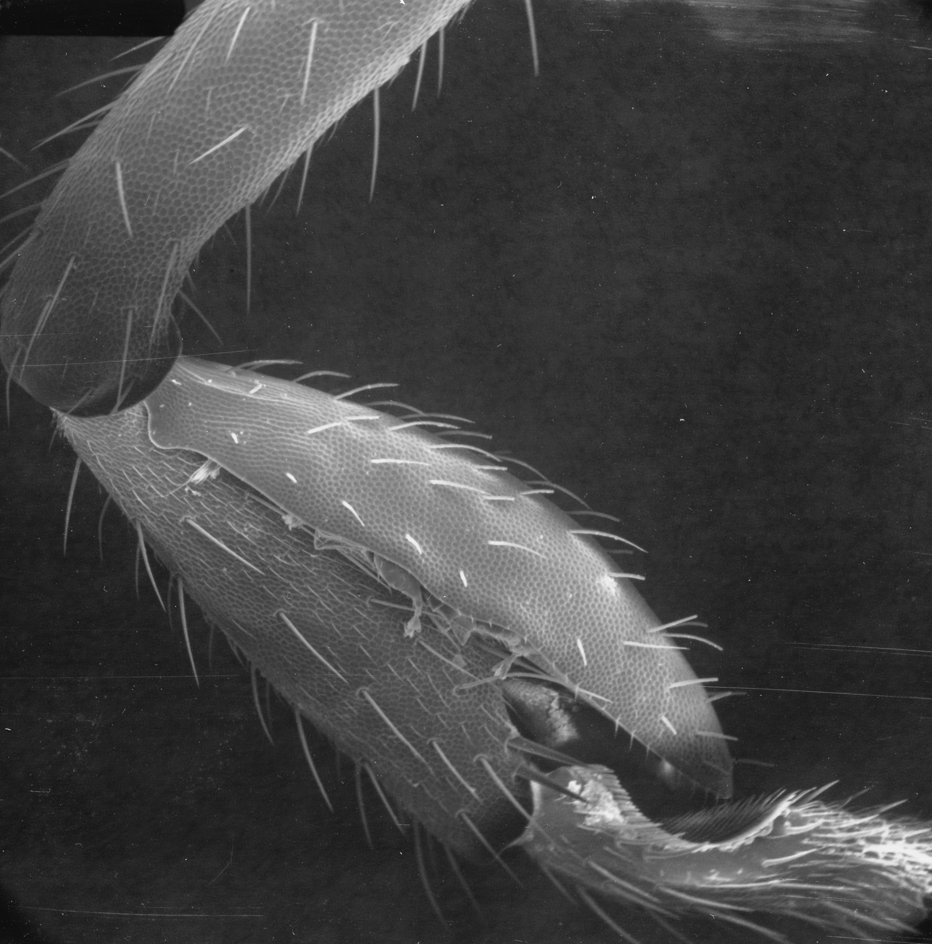
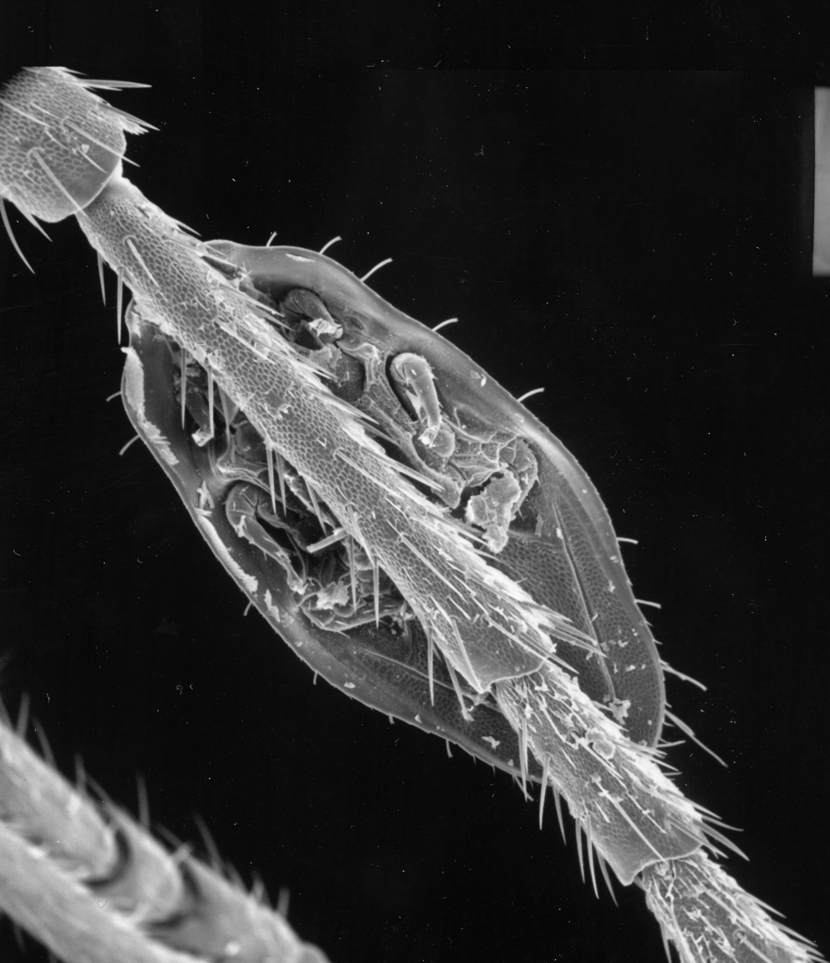
Planodiscus
Notes:
Mite guests like planodiscus attach to the legs of the ant.

Slide 24
Planodiscus
Notes:
These mites are elongated and flat and fit nicely to the inside of the leg of an army ant. They too have bristles that resemble the

Slide 25
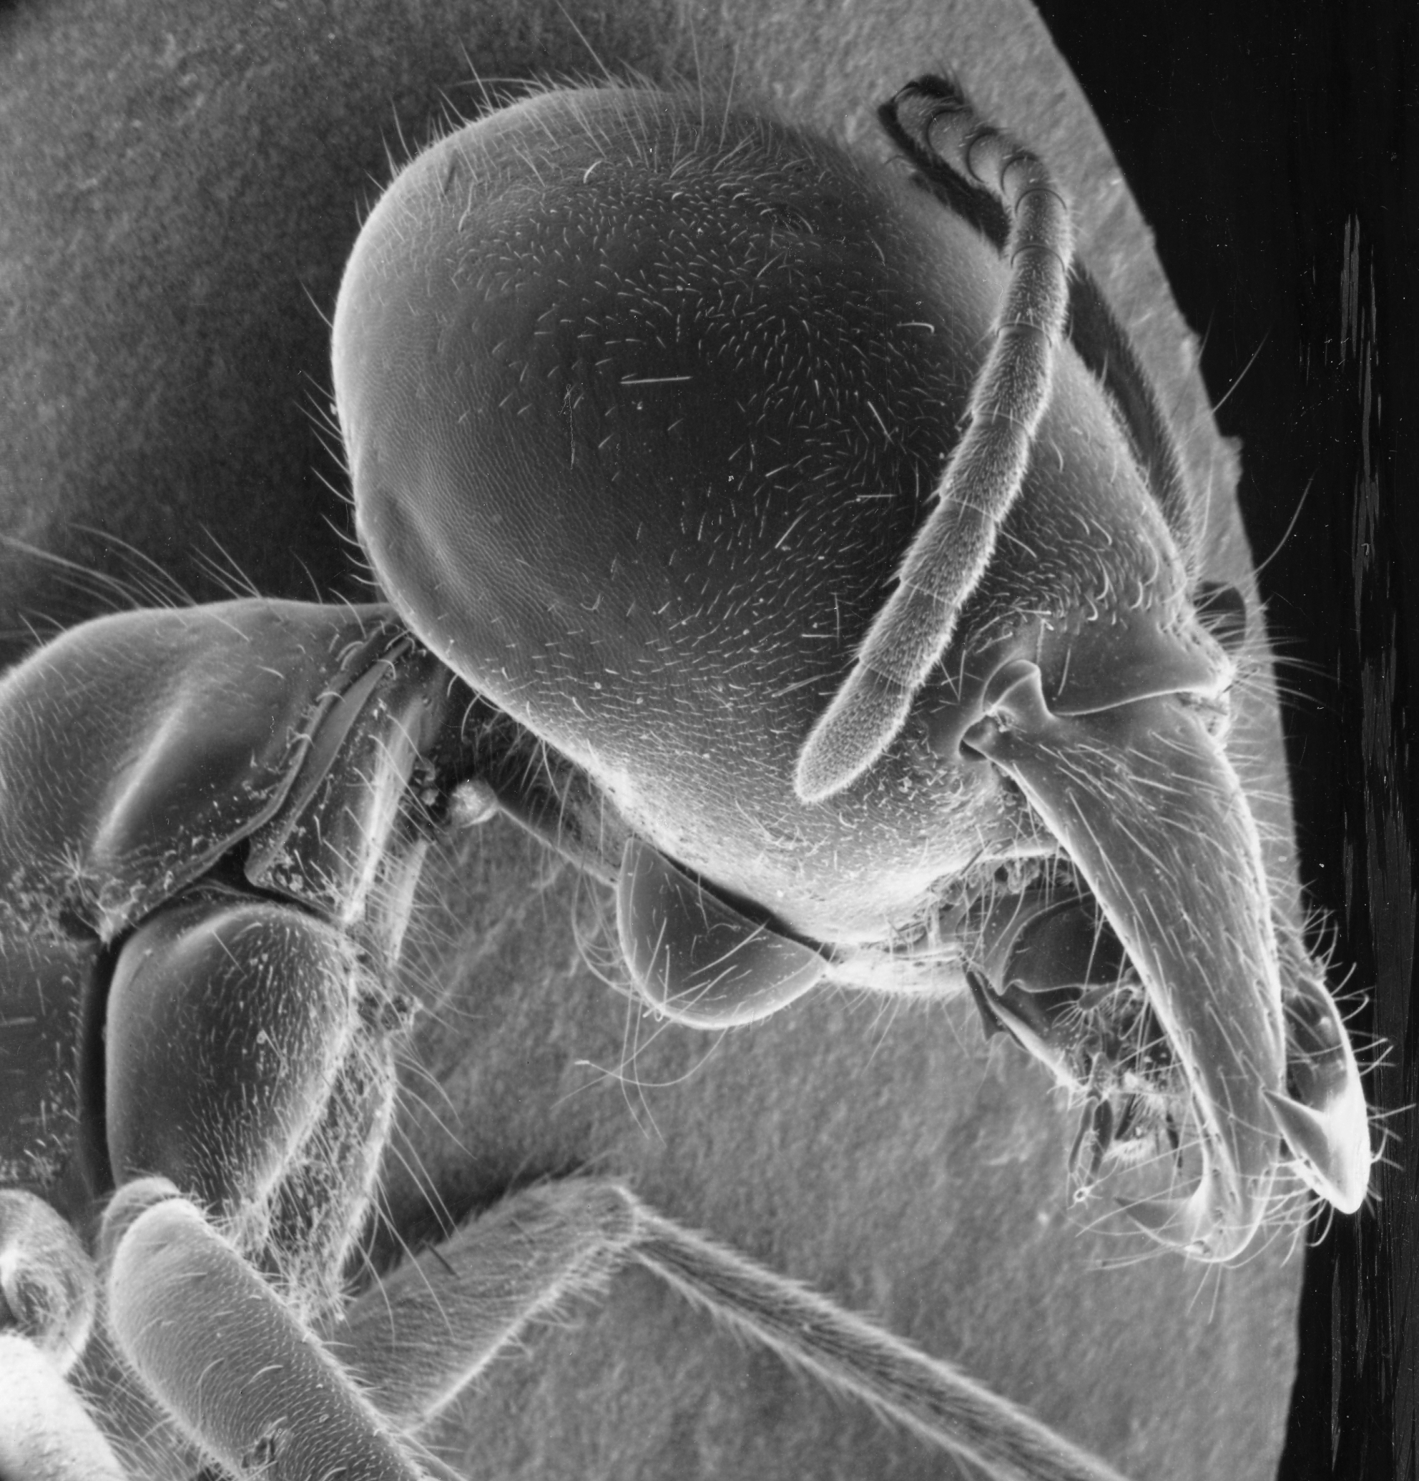
Trichocylliba
Notes:
Guest mites such as Trichocylliba live on various surfaces of the body of an ant, such as the bottom of the head.

Slide 26
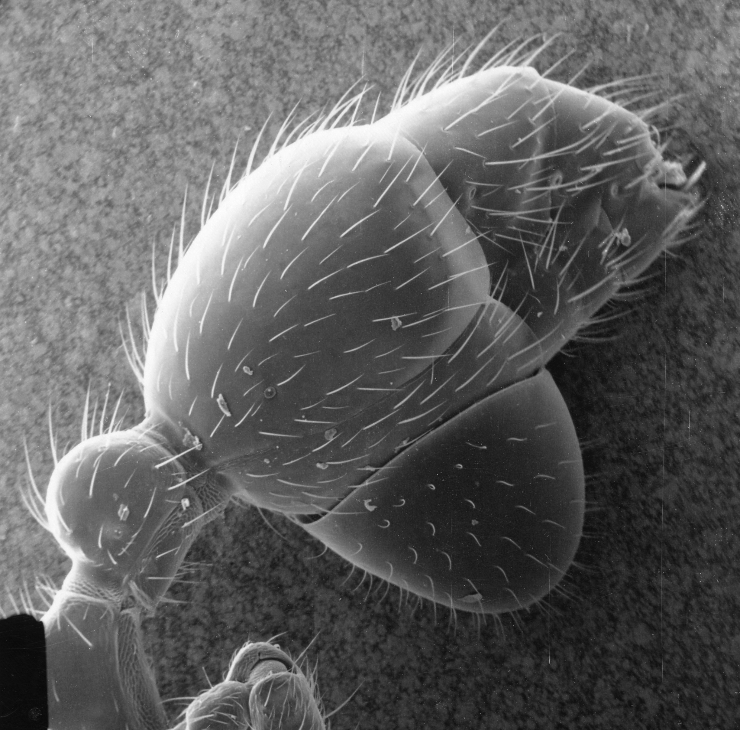
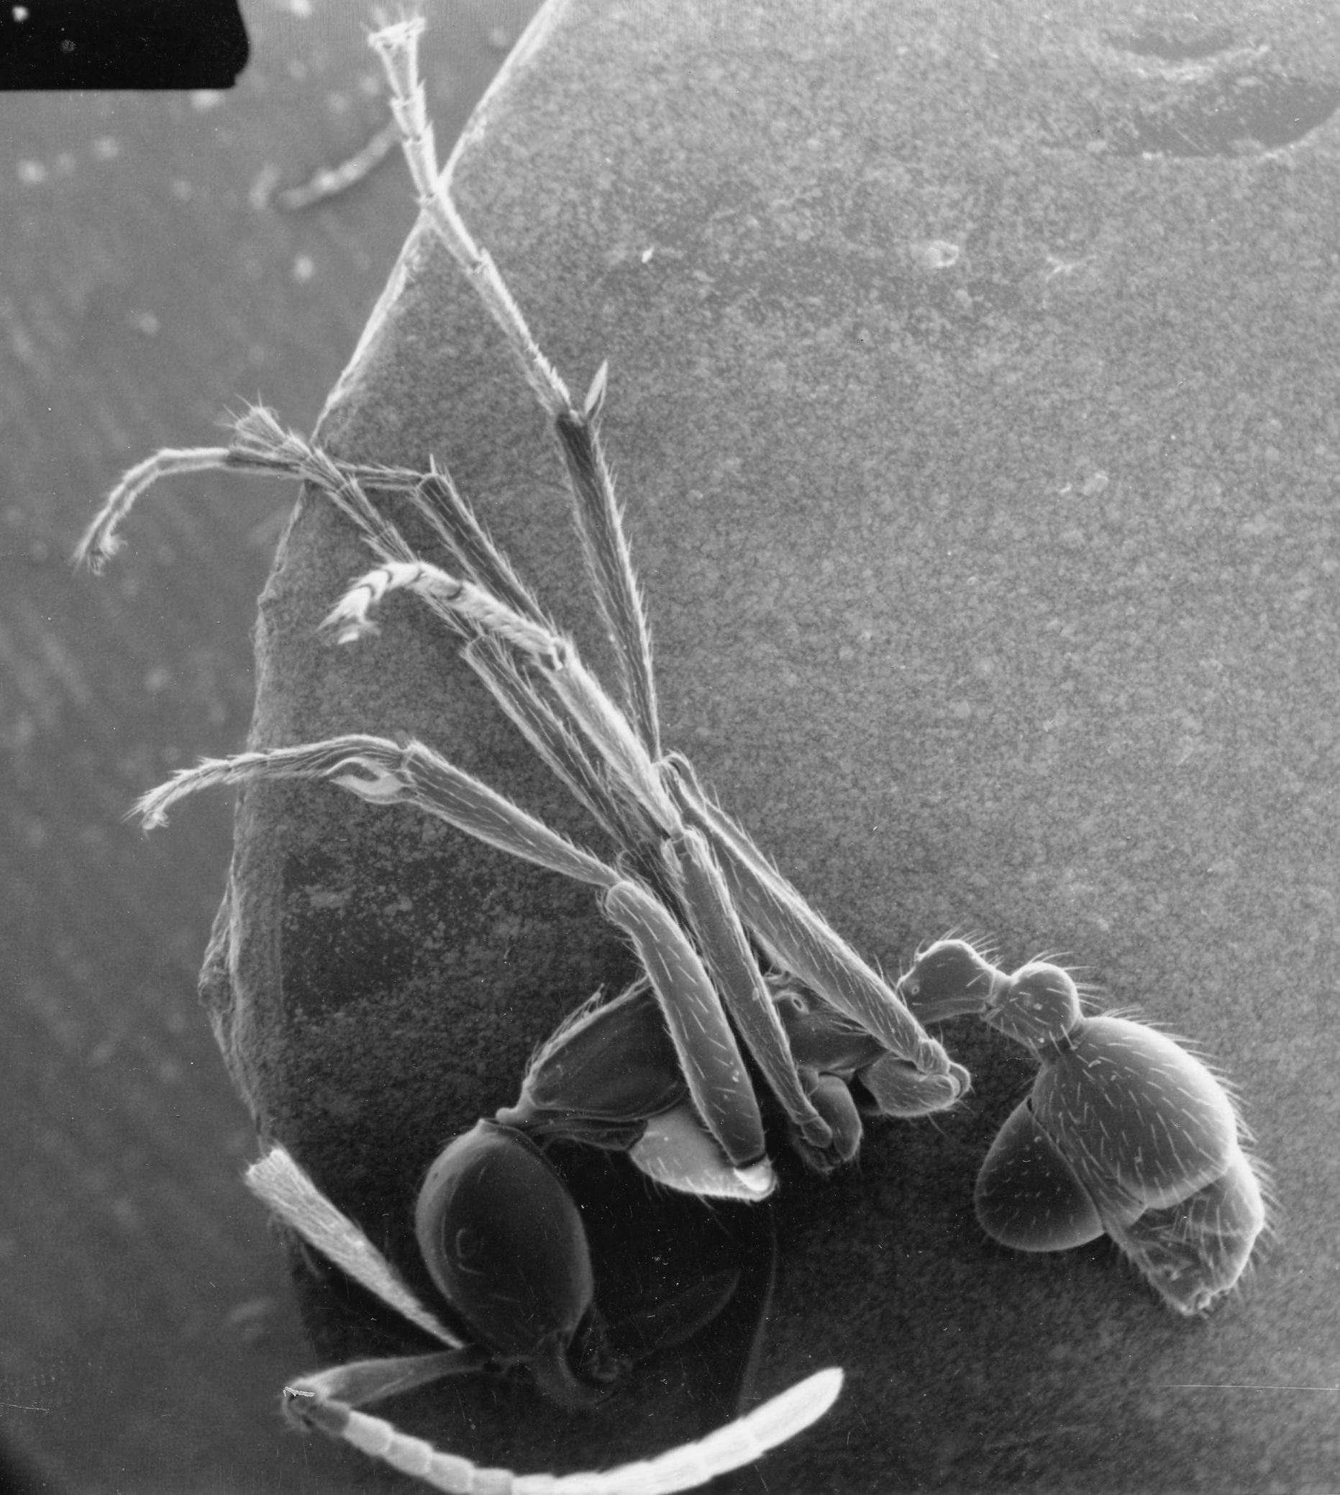
Trichocylliba
Notes:
Some live on the abdomen of the ant.

Slide 27
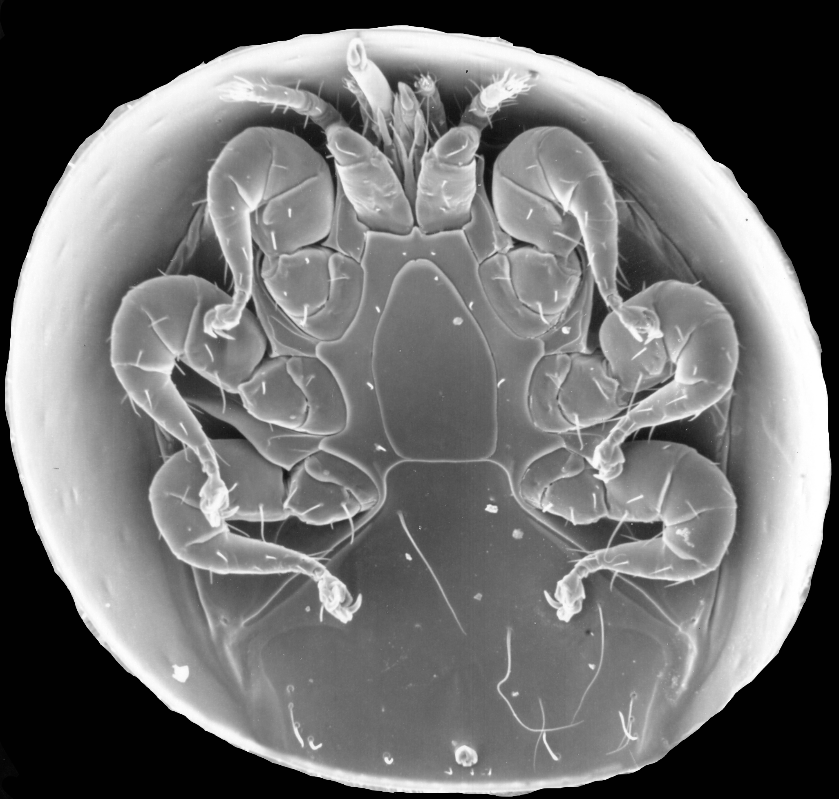
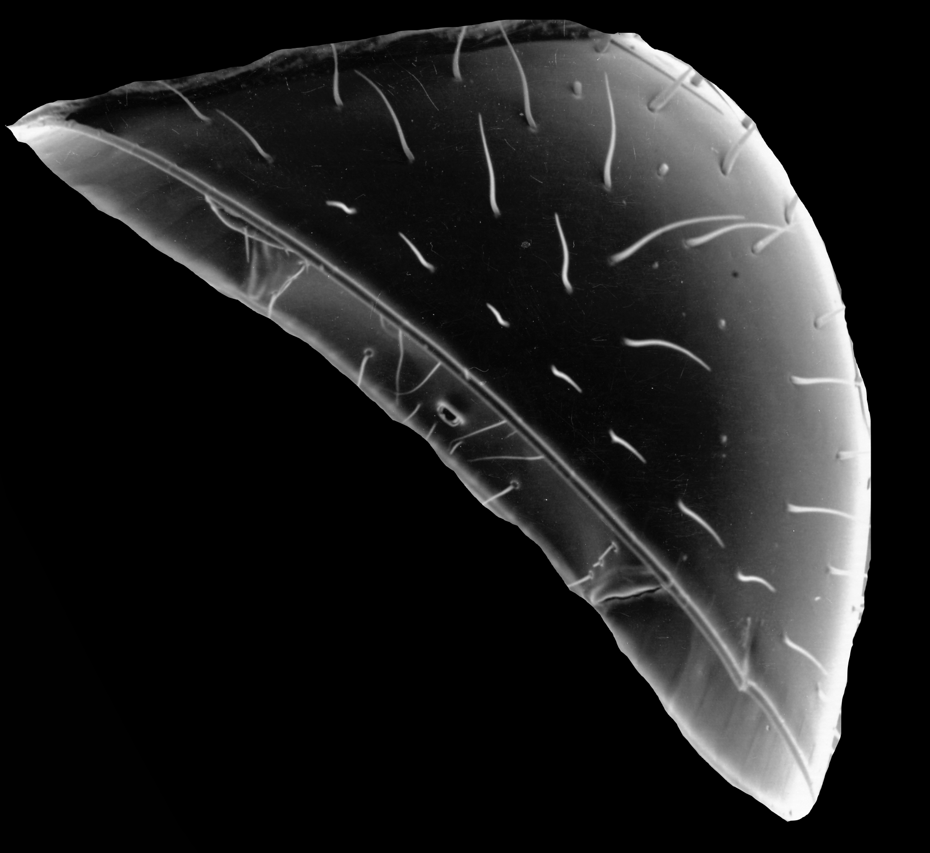
Trichocylliba
Notes:
The body of Trichocylliba is dome-shaped and it too bears bristles that resemble those of ants.

Slide 28
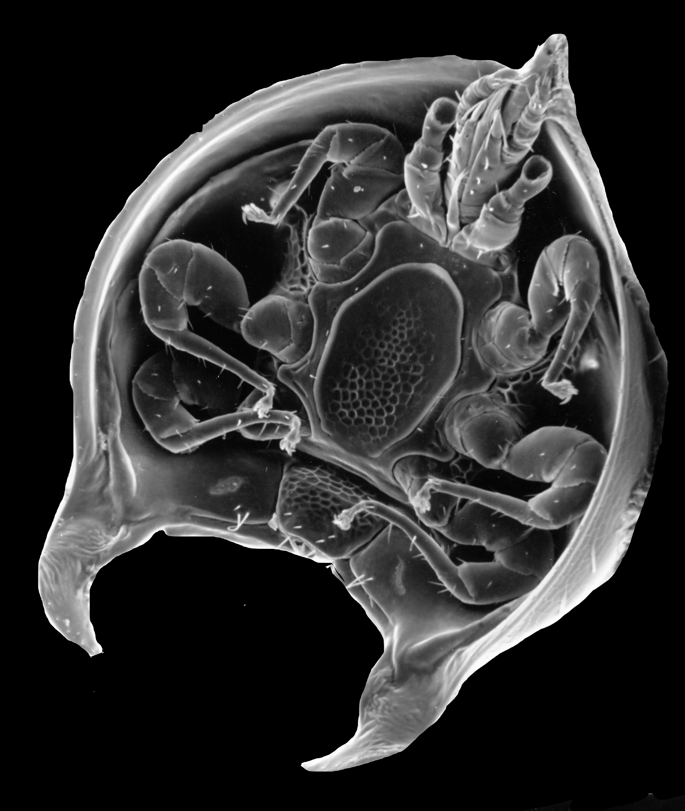
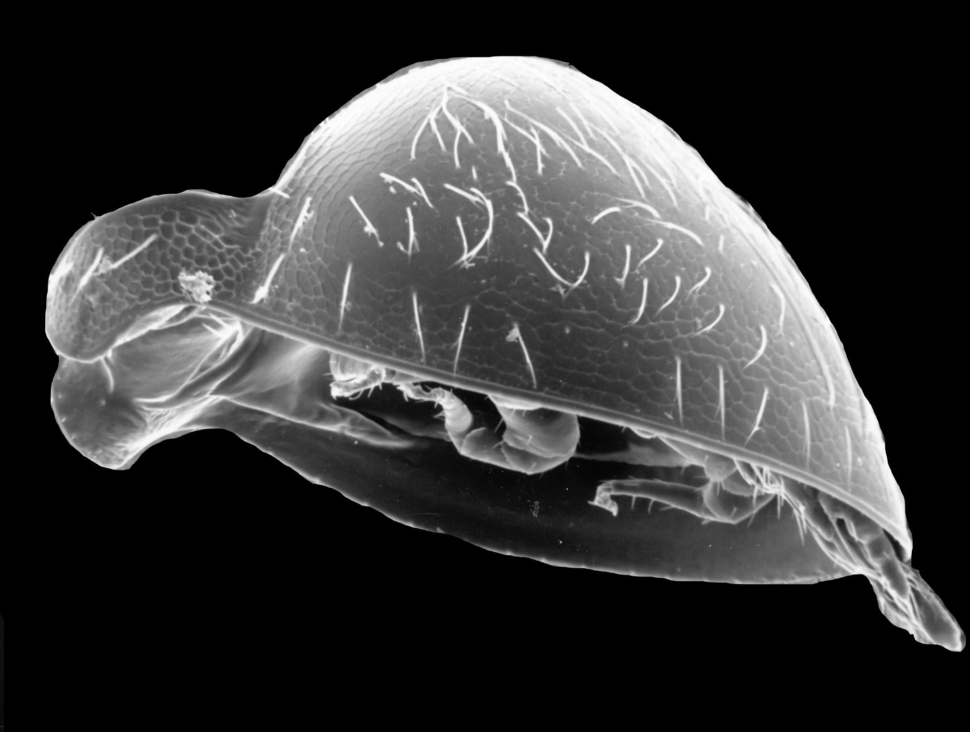
Habeogula
Head (anterior)
Posterior
Notes:
The mite guest Habeogula lives upside down with the posterior end of its body attached to the neck of an ant.

Slide 29
Macrocheles
Pinoglyphus
Planodiscus
Antennequesoma (leg)
Coxequesoma
Habeogula
Trichocylliba
Circocylliba
limulodid beetle
Antennequesoma (antenna)
Notes:
Pinoglyphus, the smallest of the guest mites, lives attached to the eye of its ant host. With the exception of limulodid beetle, all of the guests shown here are mites that are known only from the body of army ants.

Slide 31
Notes:
Many other guests live in association with army ants.

Slide 32
Notes:
They include cockroaches, silverfish, other beetles, and crickets. Ant birds follow army ants and eat insects that are flushed up from the forest floor by the emigrating colony of hundreds of thousands of army ants. There are even a whole series of small butterflies associated with army ants that obtain water from the faeces of ant birds.

Slide 33
Army ants & their “guests”
Notes:
Army ants are very tidy. In the case of the central bivouac and each of the nomadic bivouacs army ants establish a refuse depot into which they drag all of their “trash”, which includes parts of the bodies of their insect prey they do not consume as well as the bodies of ants that die.

Slide 34
Army ants & their “guests”
Notes:
A wide variety of guests are also associated with the refuse depot.

Slide 35
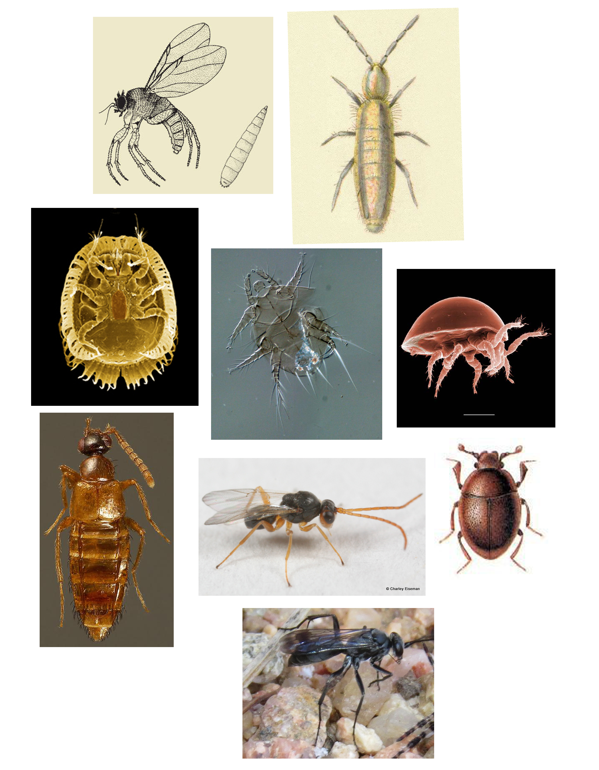
Notes:
These guests include yet other kinds of mites, beetles, flies, and wasps.

Slide 36
Army ants & their “guests”
500+ SPECIES ASSOCIATED
with
ONE species of army ant!!!
Notes:
In total Carl and Marian Rettenmeyer found more than 500 species of guests associated with the one species of army ant they studied in most detail! They believe this is the most complicated biological system known!

